Slide 1
Colors
Black
PMS Pantone Black
CMYK 0-0-0-100
RGB 0-0-0
HEX #000000
Aqua
PMS 7474 CP
CMYK 96-9-32-29
RGB 0-123-140
HEX #007B8C
Red
PMS 186
CMYK 0-100-81-4
RGB 204-9-47
HEX #CC092F
Dark Gray
PMS Cool Gray 11
CMYK 0-0-0-80
RGB 83-86-90
HEX #53565A
White
CMYK 0-0-0-0
RGB 255-255-255
HEX #FFFFFF
Purple
PMS 7678 C
CMYK 74-85-0-0
RGB 108-75-148
HEX #6C4B94
Orange
PMS 138 CP
CMYK 0-52-100-0
RGB 230-140-40
HEX #E68C28
Cool Gray 7
PMS Cool Gray 7
CMYK 0-0-0-48
RGB 151-153-155
HEX #97999B
Dark Blue
PMS 4146
CMYK 100-82-0-81
RGB 27-29-54
HEX #1B1D36
Azure
PMS 313 CP
CMYK 100-0-11-2
RGB 0-152-199
HEX #0098C7
(AA Compliant)
RGB 0-125-163
HEX #007DA3
Yellow
PMS 7408 CP
CMYK 0-29-100-0
RGB 243-186-22
HEX #F3BA16
Broadcom Gray
CMYK 0-0-0-12
RGB 226-227-228
HEX #E2E3E4
Blue
PMS 7469 C CMYK 96-64-24-6 RGB 0-92-138 HEX #005C8A
Green
PMS 369 C
CMYK 67-12-100-1
RGB 97-166-14
HEX #61A60E
(AA Compliant)
RGB 35-128-10
HEX #23800A

Slide 2
Diagram Guidelines
Mac Color File: https://drive.google.com/open?id=11YdRuhuNcH-bj0ik4mg-HMfJQeGO8buZ&usp=drive_fs
Broadcom Corporate Colors
VCF Automation = Broadcom Yellow
VCF Operations = Broadcom Green
Virtual Infrastructure = Broadcom Azure (Blue)
Security and Governance = Broadcom Purple
Data Protection and Recovery = Broadcom Red
Other Objects (icons) = black and white
General lines = Black
Styles
Boxes = Square corners (not curved)
Line Width: 1pt
Line Style: Solid or Style 3
Outer-most box (EG: Datacenter) must have white background
Solid Colors (no gradients)
No product icons
No shadows
Box Text: Aligned as heading (not separate free-text object)
Font = Metropolis

Slide 3
Design Blueprints

Slide 4
VCF Fleet in a Single Site with Minimal Footprint v1.1
Region A – Site 1
Self-Service with VCF Automation
VCF Operations
VCF Instance 1
Management Domain Cluster 1
vCenter
VCF Operations
NSX Manager
VCF Automation
Management Domain Cluster 2
NSX Edge
NSX Edge
Supervisor VM
*Second cluster required for VCF Automation All Apps Organization
Storage Site A1
Virtual Networking
Physical Network
Notes:
Version: 1.1
Original Author: Michael Kolos
Change Log:
v1.1 - 06 June 2025 by Gary Blake
Added the Design Blueprint diagram to this master deck
Adjusted the font to Metropolis, the source PPT was using Arial but could be based on someone opening the document in Google Slides
Saved the image again using SVG format to obtain a better quality image within DocWorks and also captured just the diagram removing excessive whitespace in HTML output
v1.0 - 30 May 2025 by Michael Kolos
Initial creation of VCF Fleet in a Single Site with Minimal Footprint Design Blueprint diagram using standards and guidelines

Slide 5
VCF Fleet in a Single Site v1.1
Region A – Site 1
Self-Service with VCF Automation
VCF Operations
VCF Instance 1
Management Domain Cluster
Mgmt vCenter
WLD vCenter
VCF Operations Cluster
Mgmt NSX Manager Cluster
WLD NSX Manager Cluster
VCF Automation Cluster
Workload Domain Cluster
NSX Edge
Supervisor VM
Supervisor VM
Supervisor VM
NSX Edge
Storage Site A1
Virtual Networking
Physical Network
Notes:
Version: 1.1
Original Author: Michael Kolos
Change Log:
v1.1 - 06 June 2025 by Gary Blake
Added the Design Blueprint diagram to this master deck
Adjusted the font to Metropolis, the source PPT was using Arial but could be based on someone opening the document in Google Slides
Saved the image again using SVG format to obtain a better quality image within DocWorks and also captured just the diagram removing excessive whitespace in HTML output
v1.0 - 30 May 2025 by Michael Kolos
Initial creation of VCF Fleet in a Single Site Design Blueprint diagram using standards and guidelines

Slide 6
VCF Fleet with Multiple Sites in a Single Region v1.1
Region A – Site 1
Region A – Site 2
Self-Service with VCF Automation
VCF Operations
VCF Instance 1
Management Domain Cluster
Site Affinity
Failover Capacity
Mgmt vCenter
WLD vCenter
VCF Operations Cluster
vSphere HA
Mgmt NSX Manager Cluster
WLD NSX Manager Cluster
VCF Automation Cluster
Workload Domain Cluster
Site Affinity
Site Affinity
NSX Edge
Supervisor VM Cluster
NSX Edge
Storage Site A1
Synchronous Replication
Storage Site A2
Virtual Networking
Physical Network
Layer 2 &
Layer 3
Physical Network
Notes:
Version: 1.1
Original Author: Michael Kolos
Change Log:
v1.1 - 06 June 2025 by Gary Blake
Added the Design Blueprint diagram to this master deck
Adjusted the font to Metropolis, the source PPT was using Arial but could be based on someone opening the document in Google Slides
Saved the image again using SVG format to obtain a better quality image within DocWorks and also captured just the diagram removing excessive whitespace in HTML output
v1.0 - 30 May 2025 by Michael Kolos
Initial creation of VCF Fleet with Multiple Sites in a Single Region Design Blueprint diagram using standards and guidelines

Slide 7
VCF Fleet with Multiple Sites Across Multiple Regions v1.1
Region A – Site 1
Region B – Site 2
Self-Service with VCF Automation
VCF Operations
VCF Instance 1
VCF Instance 2
Management Domain Cluster
Management Domain Cluster
Mgmt vCenter
WLD vCenter
VCF Operations Cluster
Mgmt vCenter
WLD vCenter
Mgmt NSX Manager Cluster
WLD NSX Manager Cluster
VCF Automation Cluster
Mgmt NSX Manager Cluster
WLD NSX Manager Cluster
Workload Domain Cluster
Workload Domain Cluster
NSX Edge
Supervisor VM Cluster
NSX Edge
NSX Edge
Supervisor VM Cluster
NSX Edge
Storage Site A1
*Async
Replication
Storage Site B2
Virtual Networking
Virtual Networking
Physical Network
Physical Network
Layer 3
*Optional data replication
Notes:
Version: 1.1
Original Author: Michael Kolos
Change Log:
v1.1 - 06 June 2025 by Gary Blake
Added the Design Blueprint diagram to this master deck
Adjusted the font to Metropolis, the source PPT was using Arial but could be based on someone opening the document in Google Slides
Saved the image again using SVG format to obtain a better quality image within DocWorks and also captured just the diagram removing excessive whitespace in HTML output
v1.0 - 30 May 2025 by Michael Kolos
Initial creation of VCF Fleet with Multiple Sites across Multiple Region Design Blueprint diagram using standards and guidelines

Slide 8
VCF Fleet with Multiple Sites in a Single Region Additional Region(s) v1.1
Region A – Site 1
Region A – Site 2
Region B – Site 3
Self-Service with VCF Automation
VCF Operations
VCF Instance 1
VCF Instance 2
Management Domain Cluster
Management Domain Cluster
Site Affinity
Failover Capacity
vCenters
VCF Operations Cluster
vCenters
VCF Operations Collector
vSphere HA
NSX Manager Clusters
VCF Automation Cluster
NSX Manager Clusters
Workload Domain Cluster
Workload Domain Cluster
Site Affinity
Site Affinity
NSX Edge
Supervisor VM Cluster
NSX Edge
NSX Edge
Supervisor VM Cluster
NSX Edge
Storage Site A1
Synchronous Replication
Storage Site A2
*Async
Replication
Storage Site B3
Virtual Networking
Virtual Networking
Physical Network
Layer 2 &
Layer 3
Physical Network
Physical Network
Layer 3
*Optional data replication
Notes:
Version: 1.1
Original Author: Michael Kolos
Change Log:
v1.1 - 06 June 2025 by Gary Blake
Added the Design Blueprint diagram to this master deck
Adjusted the font to Metropolis, the source PPT was using Arial but could be based on someone opening the document in Google Slides
Saved the image again using SVG format to obtain a better quality image within DocWorks and also captured just the diagram removing excessive whitespace in HTML output
v1.0 - 30 May 2025 by Michael Kolos
Initial creation of VCF Fleet with Multiple Sites across Multiple Region Design Blueprint diagram using standards and guidelines

Slide 9
VCF Private Cloud Constructs

Slide 10
VCF Private Cloud Construct v1.0
VCF Private Cloud
VCF Fleet
VCF Fleet
VCF Operations
VCF Operations
VCF Automation
VCF Automation
VCF Instance
VCF Instance
Management Domain
Management Domain
vCenter
vCenter
NSX
NSX
SDDC Manager
SDDC Manager
Workload Domains
Workload Domains
Additional VCF Instances
Additional VCF Instances
Notes:
Version: 1.0
Original Author: Brian O’Connell
Change Log:
v1.0 - 17 January 2025 by Brian O’Connell
Initial creation of VCF Private Cloud constructs diagram

Slide 11
VCF Operations Models

Slide 12
VCF Operations Models v1.1
Simple - VCF Operations
High Availability - VCF Operations
VCF Operations
VCF Instance Account
VCF Operations
VCF Operations
(Fleet Management)
Management Domain
VCF Operations
(Fleet Management)
VCF Operations
Primary node
vCenter Adapter
VCF Operations
Primary node
vSAN Adapter
VCF Instance Account
NSX Adapter
Management Domain
VCF Operations
Replica node
vCenter Adapter
Workload Domain
VCF Operations
Data node
vSAN Adapter
vCenter Adapter
NSX Adapter
VCF Operations Collectors
vSAN Adapter
VCF Operations
Collector node
NSX Adapter
Workload Domain
vCenter Adapter
VCF Operations Collectors
vSAN Adapter
VCF Operations
Collector node
NSX Adapter
Notes:
Version: 1.1
Original Author: Gary Blake
Change Log:
v1.1 - 06 June 2025 by Gary Blake
Added white solid fill to objects to handle dark mode being enabled on the technical docs site
v1.0 - 16 May 2025 by Gary Blake
Created single slide showing VCF Operations models side by side for use within the Architectural Options section

Slide 13
VCF Operations Simple Model v1.0
VCF Operations
VCF Instance Account
VCF Operations
(Fleet Management)
Management Domain
VCF Operations
Primary node
vCenter Adapter
vSAN Adapter
NSX Adapter
Workload Domain
vCenter Adapter
VCF Operations Collectors
vSAN Adapter
VCF Operations
Collector node
NSX Adapter

Slide 14
VCF Operations High Availability Model v1.0
VCF Operations
VCF Operations
(Fleet Management)
VCF Operations
Primary node
VCF Instance Account
Management Domain
VCF Operations
Replica node
vCenter Adapter
VCF Operations
Data node
vSAN Adapter
NSX Adapter
Workload Domain
vCenter Adapter
VCF Operations Collectors
vSAN Adapter
VCF Operations
Collector node
NSX Adapter

Slide 15
VCF Operations for Logs Models

Slide 16
VCF Operations for Logs Models v1.1
Simple - VCF Operations for Logs
High Availability - VCF Operations for Logs
VCF Operations
VCF Operations
VCF Operations
VCF Operations
(Fleet Management)
VCF Operations
Collector node
VCF Operations
VCF Operations
(Fleet Management)
VCF Operations
Collector node
VCF Operations for Logs
VCF Operations for Logs
Internal Load Balancer
Internal Load Balancer
VCF Operations for Logs
VCF Operations for Logs
VCF Operations for Logs
VCF Operations for Logs
VCF Instance
VCF Instance
Management Domain
Workload Domain
Management Domain
Workload Domain
vCenter
vCenter
vCenter
vCenter
NSX Manager
NSX Manager
NSX Manager
NSX Manager
SDDC Manager
SDDC Manager
Notes:
Version: 1.1
Original Author: Gary Blake
Change Log:
Added white solid fill to objects to handle dark mode being enabled on the technical docs site
v1.1 - 06 June 2025 by Gary Blake
v1.0 - 16 May 2025 by Gary Blake
Created single slide showing VCF Operations for logs models side by side for use within the Architectural Options section

Slide 17
Simple VCF Operations for Logs Model v1.0
VCF Operations
VCF Operations
VCF Operations
(Fleet Management)
VCF Operations
Collector node
VCF Operations for Logs
Internal Load Balancer
VCF Operations for Logs
VCF Instance
Management Domain
Workload Domain
vCenter
vCenter
NSX Manager
NSX Manager
SDDC Manager
Notes:
Version: 1.0
Original Author: Gary Blake
Change Log:
v1.0 – 09 June 2025 by Gary Blake
Initial creation

Slide 18
High Availability VCF Operations for Logs Model v1.0
VCF Operations
VCF Operations
VCF Operations
(Fleet Management)
VCF Operations
Collector node
VCF Operations for Logs
Internal Load Balancer
VCF Operations for Logs
VCF Operations for Logs
VCF Operations for Logs
VCF Instance
Management Domain
Workload Domain
vCenter
vCenter
NSX Manager
NSX Manager
SDDC Manager
Notes:
Version: 1.0
Original Author: Gary Blake
Change Log:
v1.0 – 09 June 2025 by Gary Blake
Initial creation

Slide 19
VCF Operations for Networks Models

Slide 20
VCF Operations for Networks Models v1.1
Simple - VCF Operations for Networks
High Availability - VCF Operations for Networks
VCF Operations
VCF Operations
VCF Operations
VCF Operations
(Fleet Management)
VCF Operations
Collector node
VCF Operations
VCF Operations
(Fleet Management)
VCF Operations
Collector node
VCF Operations for Networks
VCF Operations for Networks
VCF Operations for Networks
Platform Node
VCF Operations for Networks
Collector Node
Cluster
VCF Operations for Networks
Platform Node
VCF Operations for Networks
Platform Node
VCF Operations for Networks
Platform Node
VCF Instance
VCF Operations for Networks
Collector Node
Management Domain
Workload Domain
vCenter
vCenter
NSX Manager
NSX Manager
VCF Instance
SDDC Manager
Management Domain
Workload Domain
vCenter
vCenter
NSX Manager
NSX Manager
SDDC Manager
Notes:
Version: 1.1
Original Author: Gary Blake
Change Log:
v1.1 - 06 June 2025 by Gary Blake
Added white solid fill to objects to handle dark mode being enabled on the technical docs site
v1.0 - 16 May 2025 by Gary Blake
Created single slide showing VCF Operations for networks models side by side for use within the Architectural Options section

Slide 21
Simple VCF Operations for Networks Model v1.0
VCF Operations
VCF Operations
VCF Operations
(Fleet Management)
VCF Operations
Collector node
VCF Operations for Networks
VCF Operations for Networks
Platform Node
VCF Operations for Networks
Collector Node
VCF Instance
Management Domain
Workload Domain
vCenter
vCenter
NSX Manager
NSX Manager
SDDC Manager
Notes:
Version: 1.0
Original Author: Gary Blake
Change Log:
v1.0 – 09 June 2025 by Gary Blake
Initial creation

Slide 22
High Availability VCF Operations for Networks Model v1.0
VCF Operations
VCF Operations
VCF Operations
(Fleet Management)
VCF Operations
Collector node
VCF Operations for Networks
Cluster
VCF Operations for Networks
Platform Node
VCF Operations for Networks
Platform Node
VCF Operations for Networks
Platform Node
VCF Operations for Networks
Collector Node
VCF Instance
Management Domain
Workload Domain
vCenter
vCenter
NSX Manager
NSX Manager
SDDC Manager
Notes:
Version: 1.0
Original Author: Gary Blake
Change Log:
v1.0 – 09 June 2025 by Gary Blake
Initial creation

Slide 23
VCF Automation Models

Slide 24
VCF Automation Models v1.0
Simple - VCF Automation
High Availability - VCF Automation
VCF Automation
VCF Automation
Native Load Balancer
Native Load Balancer
VCF Automation
(Node 1)
VCF Automation
(Node 1)
VCF Automation
(Node 2)
VCF Automation
(Node 3)
Connections
Connections
Management Domain
Workload Domain
Management Domain
Workload Domain
vCenter
vCenter
vCenter
vCenter
NSX Manager
NSX Manager
NSX Manager
NSX Manager
Notes:
Version: 1.0
Original Author: Gary Blake
Change Log:
v1.0 - 16 May 2025 by Gary Blake
Created single slide showing VCF Operations for networks models side by side for use within the Architectural Options section

Slide 25
VCF Simple and HA Models Combined v2
Simple – VCF Automation
High Availability – VCF Automation
VCF Automation
VCF Automation
Native Load Balancer
Native Load Balancer
VCF Automation (Node 1)
VCF Automation (Node 1)
VCF Automation (Node 2)
VCF Automation (Node 3)
Management Domain
Workload Domain
Management Domain
Workload Domain
vCenter
vCenter
vCenter
vCenter
NSX Manager
NSX Manager
NSX Manager
NSX Manager
Notes:
Version: 1.0
Original Author: ????
Change Log:
v1.0 - ???? 2025 by ???
Initial creation

Slide 26
VCF Simple and HA Models Combined w/ External LB v2
Simple – VCF Automation
High Availability – VCF Automation
VCF Automation
VCF Automation
External Load Balancer (Optional)
External Load Balancer (Optional)
Native Load Balancer
Native Load Balancer
VCF Automation (Node 1)
VCF Automation (Node 1)
VCF Automation (Node 2)
VCF Automation (Node 3)
Management Domain
Workload Domain
Management Domain
Workload Domain
vCenter
vCenter
vCenter
vCenter
NSX Manager
NSX Manager
NSX Manager
NSX Manager
Notes:
Version: 1.0
Original Author: ????
Change Log:
v1.0 - ???? 2025 by ???
Initial creation

Slide 27
VCF Automation - Object Flow v2
Organization Construct Hierarchy
Organization
Project
vSphere Supervisor
VCF Networking with VPC
VM Workloads
vSphere Namespace
Container Workloads
Notes:
Version: 1.0
Original Author: ????
Change Log:
v1.0 - ???? 2025 by ???
Initial creation
Talk Track:
This is a high-level view of the constructs that comprise an Organization
Organizations – A top-level entity used to group and manage resources, users, policies, IaaS services, and catalog entities, while maintaining a secure boundary from other organizations
Projects – Connect users with the resources they are entitled to and the limits to which they are subject
Supervisor Clusters - Built on VKS using VCF Networking with Virtual Private Clouds (VPCs)
VCF Networking with VPC - Provides an isolated domain of networking resources that can be associated with one or more isolated domains of compute resources (vSphere namespace)
vSphere Namespaces - Define resource limits for CPU, memory, and storage for workloads such as VMs, Kubernetes clusters, and others
Workloads - Traditional VMs and container-based deployments within same infrastructure & managed with the same tools

Slide 28
Org Hierarchy with VPC v2
VCF Automation
Organization 01
Organization 01
Project 01
Project N
Project 01
Project N
VCF Networking with VPC
VCF Networking with VPC
VCF Networking with VPC
VCF Networking with VPC
VCF Networking with VPC
VCF Networking with VPC
VCF Networking with VPC
VCF Networking with VPC
vSphere Namespace 01
vSphere Namespace N
vSphere Namespace 01
vSphere Namespace N
vSphere Namespace 01
vSphere Namespace N
vSphere Namespace 01
vSphere Namespace N
Workload 1
Workload 1
Workload 1
Workload 1
Workload 1
Workload 1
Workload 1
Workload 1
Workload 2
Workload 2
Workload 2
Workload 2
Workload 2
Workload 2
Workload 2
Workload 2
Workload N
Workload N
Workload N
Workload N
Workload N
Workload N
Workload N
Workload N
Notes:
Version: 1.0
Original Author: ????
Change Log:
v1.0 - ???? 2025 by ???
Initial creation

Slide 29
Provider Consumption Org v1
Flow Chart
VCF Automation
Provider / Enterprise Admin
Provider Management Functions
Provider Consumption Organization (PCO)
Visibility to allow for publishing of catalog items from PCO to Organizations
Organization 1
Organization 2
Organization N
Notes:
Version: 1.0
Original Author: ????
Change Log:
v1.0 - ???? 2025 by ???
Initial creation

Slide 30
Example – Supervisor to Organization Relationship v1
Shared Infrastructure
Organization BigCo
Organization SmallCo
Tenant Level
Project - Apple
Project - Pear
Project - Corp
vSphere Namespace: Crisp
vSphere Namespace: Bartlett
BigCo
Org
Admins
vSphere Namespace: Finance
SmallCo
Org
Admins
vSphere Namespace: Mac
vSphere Namespace: Bosc
vSphere Namespace: Plant
zone1
zone2
zone3
zone4
zone5
zone6
zone1
zone2
zone3
Provider Level
vSphere
Cluster
vSphere
Cluster
vSphere
Cluster
vSphere
Cluster
vSphere
Cluster
vSphere
Cluster
vSphere
Cluster
vSphere
Cluster
vSphere
Cluster
Region West
vSphere Supervisor 1
Region East
Provider Admins
vSphere Supervisor 2
vSphere Supervisor 1
vCenter West 1
vCenter West 2
vCenter East 1
NSX Local Manager West
NSX Local Manager East
Notes:
Version: 1.0
Original Author: ????
Change Log:
v1.0 - ???? 2025 by ???
Initial creation
Talk Track:
Technical view of showing further detail on how multiple organizations/tenants with multiple projects can be assigned on certain resources within the vSphere Supervisor infrastructure.
Specifically, this view shows
2 Tenants across 2 Regions
Regions
Region 1 includes two separate vCenters sharing one NSX Manager deployment
Region 2 single vCenter/NSX Pair
Tenant #1 – BigCo
2 Projects
2 vSphere Namespaces per Project
Region Quotas
One Region Quota assigning resources to Region West - vSphere Supervisor 1
One Region Quota assigning resources to Region East - vSphere Supervisor 1
Tenant #2 – Small Co
1 Project
2 vSphere Namespaces
One Region Quota assigning resources to Region West - vSphere Supervisor 2
One Region Quota assigning resources to Region East - vSphere Supervisor 1
Note: Each Organization requires a Region Quota that maps the Supervisor in the Region to the Organization. Each Region can only map 1 Supervisor per region. This is why you see BigCo mapped to Region West Supervisor 1 and SmallCo mapped to Region West Supervisor 2.

Slide 31

VCF Automation Org Model v1
VCF Automation Organization for All Apps
Project
Project Admins
Zones
vSphere Namespace
VM Classes
Storage Classes
Org
Admins
Content Libraries
VPC
Connectivity Profile
Private VPC CIDR
Private TGW IP Blocks
w.x.y.z
a.b.c.d
Org IAM
Org IdP
VCF Automation Provider Level
zone1
zone2
zone3
Provider Gateway
Regional Quota
vSphere
Cluster
vSphere
Cluster
vSphere
Cluster
Shared Content Libraries
T0 Gateway
Region
Default Namespaces
External IP Blocks
Provider Admins
vSphere Supervisor
StorageClasses
e.f.g.h
vCenter
VirtualMachineClasses
NSX Local Manager
Provider IAM
Provider IdP
Notes:
Version: 1.0
Original Author: ????
Change Log:
v1.0 - ???? 2025 by ???
Initial creation
Talk Track:
Technical view of showing further detail on how multiple organizations/tenants with multiple projects can be assigned on certain resources within the vSphere Supervisor infrastructure.
Specifically, this view shows
2 Tenants across 2 Regions
Regions
Region 1 includes two separate vCenters sharing one NSX Manager deployment
Region 2 single vCenter/NSX Pair
Tenant #1 – BigCo
2 Projects
2 vSphere Namespaces per Project
Region Quotas
One Region Quota assigning resources to Region West - vSphere Supervisor 1
One Region Quota assigning resources to Region East - vSphere Supervisor 1
Tenant #2 – Small Co
1 Project
2 vSphere Namespaces
One Region Quota assigning resources to Region West - vSphere Supervisor 2
One Region Quota assigning resources to Region East - vSphere Supervisor 1
Note: Each Organization requires a Region Quota that maps the Supervisor in the Region to the Organization. Each Region can only map 1 Supervisor per region. This is why you see BigCo mapped to Region West Supervisor 1 and SmallCo mapped to Region West Supervisor 2.

Slide 32
Chargeback Integration with VCF Operation v1.1
VCF Operations
VCF Automation Management Pack
Data Collection
VCF
Automation
Pricing Engine
VCF Automation Management Pack
Data Collection
vCenter
Billing
Engine
VCF Automation Management Pack
NSX
Data Collection
Notes:
Version: 1.1
Original Author: Shree Das
Change Log:
v1.1 – 11th June 2025 Gary Blake
Applied diagram standards for box colours and line width
Added white solid fill to objects to handle dark mode being enabled on the technical docs site
v1.0 – 2nd February 2025 by Shree Das
Initial creation

Slide 33
Workload Domain Models

Slide 34
Workload Domain Models v1.1
VCF Instance
Management Domain
Workload Domain
vCenter
vCenter
NSX Manager
NSX Manager
SDDC Manager
Notes:
Version: 1.1
Original Author: Gary Blake
Change Log:
v1.1 - 06 June 2025 by Gary Blake
Added white solid fill to objects to handle dark mode being enabled on the technical docs site
v1.0 - 16 May 2025 by Gary Blake
Created single slide showing Workload Domain models side by side for use within the Architectural Options section

Slide 35
Management Domain Model v1.0
Management Domain
VCF Operations
VCF Operations
VCF Operations
Collector
VCF Operations
Fleet Management
VCF Operations
for Logs
VCF Operations
for Networks
VCF Automation
NSX Manager
vCenter
SDDC Manager
Notes:
Version: 1.0
Original Author: Brian O’Connell
Change Log:
v1.0 - 16 January 2025 by Brian O’Connell
Initial creation

Slide 36
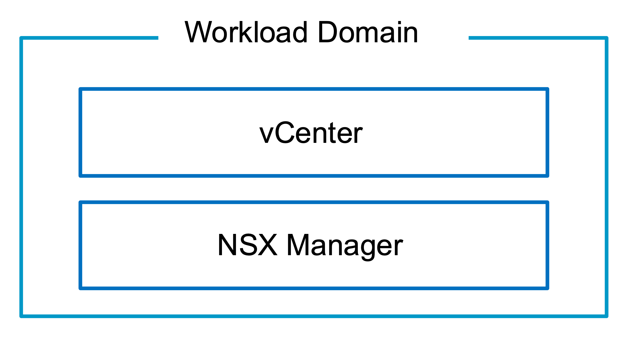
Workload Domain Model v1.0
Workload Domain
vCenter
NSX Manager
Notes:
Version: 1.0
Original Author: Brian O’Connell
Change Log:
v1.0 - 16 January 2025 by Brian O’Connell
Initial creation

Slide 37
vSphere Cluster Models

Slide 38
vSphere Cluster Models v1.1
VCF Instance
Availability Zone 1
Availability Zone 2
Rack
Rack
Rack
Rack
Workload Domain 1
Single Rack Cluster
Single Rack Cluster
Workload Domain 2
Single Rack Cluster
Multi Rack Cluster
Single Rack Cluster
Stretched Cluster
Workload Domain 3
Storage Cluster
Compute Cluster
Notes:
Version: 1.1
Original Author: Brian O’Connell
Change Log:
v1.1 - 06 June 2025 by Gary Blake
Removed the cluster model names from outside the VCF Instance box
v1.0 - 16 May 2025 by Gary Blake
Updated for diagram standards
v0.1 - 18 Dec 2024 by Brian O’Connell
Initial draft creation of the diagram

Slide 39
vSphere Cluster Models v1.0
VCF Instance
VCF Instance
Availability Zone 1
Availability Zone 1
Rack
Rack
Rack
Rack
Workload Domain 1
Workload Domain 1
Standard Cluster
Multi Rack Cluster
Standard Cluster
VCF Instance
Availability Zone 1
Availability Zone 2
Rack
Rack
Workload Domain 1
Stretched Cluster
Notes:
Version: 1.1
Original Author: Brian O’Connell
Change Log:
v1.0 - 09 June 2025 by Gary Blake
Updated for diagram standards
v0.1 - 18 Dec 2024 by Brian O’Connell
Initial draft creation of the diagram

Slide 40


Layer 2 Multi-Rack Cluster Model v1.0
Layer 2 Adjacencies
Rack 1
Rack 2
Rack 3
Rack 4
Rack 1 Switches
Rack 2 Switches
Rack 3 Switches
Rack 4 Switches
Layer 2 vSphere Cluster
VM Management
ESX Management
vMotion
IP Storage (NFS/vSAN)
NSX Host TEP
Notes:
Version: 1.0
Original Author: Cathal Penderville
Change Log:
v1.0 - 09 June 2025 by Cathal Penderville
Initial diagram creation

Slide 41
Layer 3 Multi-Rack Cluster Model v1.0
Layer 3 Boundaries
Layer 2 Adjacencies
Layer 2 Adjacencies
Layer 2 Adjacencies
Layer 2 Adjacencies
Rack 1
Rack 2
Rack 3
Rack 4
Rack 1 Switches
Rack 2 Switches
Rack 3 Switches
Rack 4 Switches
Layer 3 vSphere Cluster
VM Management
Rack 1
VM Management
Rack 2
VM Management
Rack 3
VM Management
Rack 4
ESX Management
Rack 1
ESX Management
Rack 2
ESX Management
Rack 3
ESX Management
Rack 4
vMotion
Rack 1
vMotion
Rack 2
vMotion
Rack 3
vMotion
Rack 4
IP Storage (NFS/vSAN)
Rack 1
IP Storage (NFS/vSAN)
Rack 2
IP Storage (NFS/vSAN)
Rack 3
IP Storage (NFS/vSAN)
Rack 4
NSX Host TEP
Rack 1
NSX Host TEP
Rack 2
NSX Host TEP
Rack 3
NSX Host TEP
Rack 4
Notes:
Version: 1.0
Original Author: Cathal Penderville
Change Log:
v1.0 - 09 June 2025 by Cathal Penderville
Initial diagram creation

Slide 42
VCF Edge

Slide 43
TO BE ADDED

Slide 44
Distributed Switch Models

Slide 45
Distributed Switch Models v1.1
Single
Distributed Switch
Storage Separation
Distributed Switch
Workload Separation
Distributed Switch
Storage and Workload Separation
Distributed Switch
ESX Host
ESX Host
ESX Host
ESX Host
VM Mgmt
vDS Uplinks
VM Mgmt
vDS Uplinks
VM Mgmt
vDS Uplinks
VM Mgmt
vDS Uplinks
ESX Mgmt
ESX Mgmt
ESX Mgmt
ESX Mgmt
vMotion
vMotion
vMotion
vMotion
Storage
Virtual Networking
Storage
vDS Uplinks
Storage
Virtual Networking
vDS Uplinks
vDS Uplinks
Storage
Virtual Networking
vDS Uplinks
Virtual Networking
Notes:
Version: 1.1
Original Author: Gary Blake
Change Log:
v1.1 - 06 June 2025 by Gary Blake
Added white solid fill to objects to handle dark mode being enabled on the technical docs site
v1.0 - 16 May 2025 by Gary Blake
Created single slide showing Distributed Switch models side by side for use within the Architectural Options section

Slide 46
Single Distributed Switch Model v1.1
ESX Host
vDS Uplinks
vDS01
VM Management
ESX Management
vMotion
Storage
Virtual Networking
Notes:
Version: 1.1
Original Author: Cathal Prendeville
Change Log:
v1.1 - 06 June 2025 by Gary Blake
Updated ESX Management line color to match standards
Updated the switch objects to reverse the black and white based on standards
Reduced the size of the boxes so there is not so much white space
v1.0 – 3rd March 2025 by Cathal Prendeville
Initial creation

Slide 47
Storage Separation Distributed Switch Model v1.2
Switch-A
Switch-B
pNIC1
pNIC2
pNIC3
pNIC4
ESX Host
Uplink1
Uplink2
Uplink1
Uplink2
NSX Host TEP1
vDS01 with NSX
NSX Host TEP2
vDS02
VM Management
dPG
ESX Management
dPG
vMotion
dPG
Storage
dPG
Notes:
Version: 1.2
Original Author: Cathal Prendeville
Change Log:
v1.2 - 09 June 2025 by Gary Blake
Increased the size of dPG boxes to display `Management` rather than `Mgmt`
Moved the vDS names into the main box rather than sperate text boxes
Reversed colors on the switch boxes
v1.1 - 20 May 2025 by Cathal Prendeville
Updated to match standards defined
v1.0 – 3rd March 2025 by Cathal Prendeville
Initial creation

Slide 48
Workload Separation Distributed Switch v1.2
Switch-A
Switch-B
pNIC1
pNIC2
pNIC3
pNIC4
ESX Host
Uplink1
Uplink2
Uplink1
Uplink2
vDS01
NSX Host TEP1
NSX Host TEP2
vDS02 with NSX
VM Management
dPG
ESX Management dPG
vMotion
dPG
Storage
dPG
Notes:
Version: 1.2
Original Author: Cathal Prendeville
Change Log:
v1.2 - 09 June 2025 by Gary Blake
Increased the size of dPG boxes to display `Management` rather than `Mgmt`
Moved the vDS names into the main box rather than sperate text boxes
Reversed colors on the switch boxes
v1.1 - 20 May 2025 by Cathal Prendeville
Updated to match standards defined
v1.0 – 3rd March 2025 by Cathal Prendeville
Initial creation

Slide 49
Storage and Workload Separation Distributed Switch v1.2
Switch-A
Switch-B
pNIC1
pNIC2
pNIC3
pNIC4
pNIC5
pNIC6
ESX Host
Uplink1
Uplink2
Uplink1
Uplink2
Uplink1
Uplink2
vDS01
NSX
Host TEP1
vDS02 with NSX
NSX
Host TEP2
vDS03 with Storage
VM Management dPG
ESX Management dPG
vMotion
dPG
Storage
dPG
vDS02 with NSX
Notes:
Version: 1.2
Original Author: Cathal Prendeville
Change Log:
v1.2 - 09 June 2025 by Gary Blake
Increased the size of dPG boxes to display `Management` rather than `Mgmt`
Moved the vDS names into the main box rather than sperate text boxes
Reversed colors on the switch boxes
v1.1 - 20 May 2025 by Cathal Prendeville
Updated to match standards defined
v1.0 – 3rd March 2025 by Cathal Prendeville
Initial creation

Slide 50
Dedicated vSphere Cluster for NSX Edge Node Distributed Switch Model v1.2
Switch-A
Switch-B
pNIC1
pNIC2
pNIC3
pNIC4
ESX Host
Uplink1
Uplink2
Uplink1
Uplink2
vDS01
NSX Host TEP1
NSX Host TEP2
vDS02 with NSX
ESX Management
vMotion
Storage
Edge VM Management dPG
Edge 01 Trunk dPG A
Edge 01Trunk dPG B
Edge VM Management dPG
Edge 02 Trunk
dPG A
Edge 02 Trunk
dPG B
_ _ _ _ _ _
_ _ _ _ _ _
Edge Node 01
P
V
P
V
Edge Node 02
Notes:
Version: 1.2
Original Author: Cathal Prendeville
Change Log:
v1.2 - 09 June 2025 by Gary Blake
Fixed dPG with curved corners and not square corners
Increased the size of dPG boxes to display `Management` rather than `Mgmt`
Moved the vDS names into the main box rather than sperate text boxes
Reversed colors on the switch boxes
v1.1 - 20 May 2025 by Cathal Prendeville
Updated to match standards defined
v1.0 – 3rd March 2025 by Cathal Prendeville
Initial creation

Slide 51
vSAN Storage Cluster Separation Distributed Switch Model v1.2
Fabric
Switch-A
Fabric
Switch-B
Storage Fabric
Switch-A
Storage Fabric Switch-B
pNIC1
pNIC2
pNIC3
pNIC4
ESX Host
Uplink1
Uplink2
Uplink1
Uplink2
NSX Host TEP1
vDS02 with vSAN Storage
vDS01 with NSX
NSX Host TEP2
VM Management
dPG
ESX Management
dPG
vMotion
dPG
vSAN Client
dPG
vSAN Storage
dPG
Notes:
Version: 1.2
Original Author: Cathal Prendeville
Change Log:
v1.2 - 09 June 2025 by Gary Blake
Increased the size of dPG boxes to display `Management` rather than `Mgmt`
Moved the vDS names into the main box rather than sperate text boxes
Reversed colors on the switch boxes
v1.1 - 20 May 2025 by Cathal Prendeville
Updated to match standards defined
v1.0 – 3rd March 2025 by Cathal Prendeville
Initial creation

Slide 52
Fleet Level Components Networking

Slide 53
Fleet Level Management on Shared Management Network Model v1.1
VM Management
VLAN
VM Management
VLAN
External Connectivity
External Connectivity
Management Domain
Management Domain
VM Management
Port Group
VM Management
Port Group
Management VMs
Management VMs
Fleet Level VMs
Fleet Level VMs
VCF Operations
Collector(s)
vCenter(s)
vCenter(s)
NSX Manager(s)
NSX Manager(s)
SDDC Manager
SDDC Manager
VCF Automation
VCF Automation
VCF Ops
VCF Operations
VCF Ops for Logs
VCF Operations for Logs
VCF Operations for Networks
Notes:
Version: 1.1
Original Author: Cathal Prendeville
Change Log:
v1.1 - 09 June 2025 by Gary Blake
Updated `Ops` to `Operations`
v1.0 – 12th May 2025 by Cathal Prendeville
Initial creation

Slide 54
Fleet Level Components on Dedicated Management Network Model v1.1
VM Management
VLAN
External Connectivity
Fleet Level Management
VLAN
Management Domain
VM Management
Port Group
Fleet Level Management
Port Group
Management VMs
Fleet Level VMs
VCF Operations
Collector(s)
vCenter(s)
NSX Manager(s)
SDDC Manager
VCF Automation
VCF Operations
VCF Operations for Logs
VCF Operations for Networks
Notes:
Version: 1.1
Original Author: Cathal Prendeville
Change Log:
v1.1 - 09 June 2025 by Gary Blake
Updated `Ops` to `Operations`
v1.0 – 12th May 2025 by Cathal Prendeville
Initial creation

Slide 55
Fleet Level Components on NSX Overlay Segment Model v1.1
VM Management
VLAN
External Connectivity
Edge Uplinks/TEP VLANs
Management Domain
BGP/Static Routing
P
V
P
V
Tier-1 Gateway
VM Management
Port Group
Tier-0 Gateway
Fleet Level Management NSX Overlay Segment
Management VMs
Fleet Level VMs
VCF Operations
Collector(s)
vCenter(s)
NSX Manager(s)
SDDC Manager
VCF Automation
VCF Operations
VCF Operations for Logs
VCF Operations for
Networks
Notes:
Version: 1.1
Original Author: Cathal Prendeville
Change Log:
v1.1 - 09 June 2025 by Gary Blake
Updated `Ops` to `Operations`
Reversed colors on the switch boxes
v1.0 – 12th May 2025 by Cathal Prendeville
Initial creation

Slide 56
Fleet Level Components on NSX VLAN Segment Model v1.1
VM Management
VLAN
External Connectivity
Fleet Level Management
VLAN
Management Domain
VM Management
Port Group
Fleet Level Management NSX VLAN Segment
Management VMs
Fleet Level VMs
VCF Operations
Collector(s)
vCenter(s)
NSX Manager(s)
SDDC Manager
VCF Automation
VCF Operations
VCF Operations for Logs
VCF Operations for Networks
Notes:
Version: 1.1
Original Author: Cathal Prendeville
Change Log:
v1.1 - 09 June 2025 by Gary Blake
Updated `Ops` to `Operations`
v1.0 – 12th May 2025 by Cathal Prendeville
Initial creation

Slide 57
Fleet Level Components on NSX Overlay Stretched Segment Model v1.1
VCF Instance 1 – Region A
VCF Instance 2 – Region B
VM Management
VLAN
External Connectivity
Edge Uplinks/TEP VLANs
Edge Uplinks/TEP VLANs
External Connectivity
VM Management
VLAN
BGP
Routing
BGP Routing
P
V
P
V
P
V
P
V
VM Management
Port Group
Stretched Tier-0 Gateway
Active/Active Primary/Primary
VM Management
Port Group
Management VMs
Management VMs
VCF Operations
Collector(s)
vCenter(s)
NSX Local/Global Manager(s)
SDDC Manager
Stretched Tier-1 Gateway
Active/Standby Primary/Secondary
SDDC Manager
NSX Local/Global Manager(s)
vCenter(s)
VCF Operations
Collector(s)
Fleet Level Management NSX Stretched Overlay Segment
Fleet Level Management VMs
VCF Automation
VCF Operations
VCF Operations for Logs
VCF Operations for
Networks
*Optional Failover of Fleet Level VMs
*Requires VMware Live Recovery

Slide 58
vSAN Diagrams

Slide 59


Standard vSAN Cluster v1.1
VCF Instance
Workload Domain
Availability Zone
Rack
vSAN Cluster
Notes:
Version: 1.1
Original Author: Paudie O’Riordan
Change Log:
v1.1 – 9th June 2025 by Paudie Oriordan
SVG import readiness
v1.0 – 19th May 2025 by Paudie O’Riordan
Initial creation

Slide 60
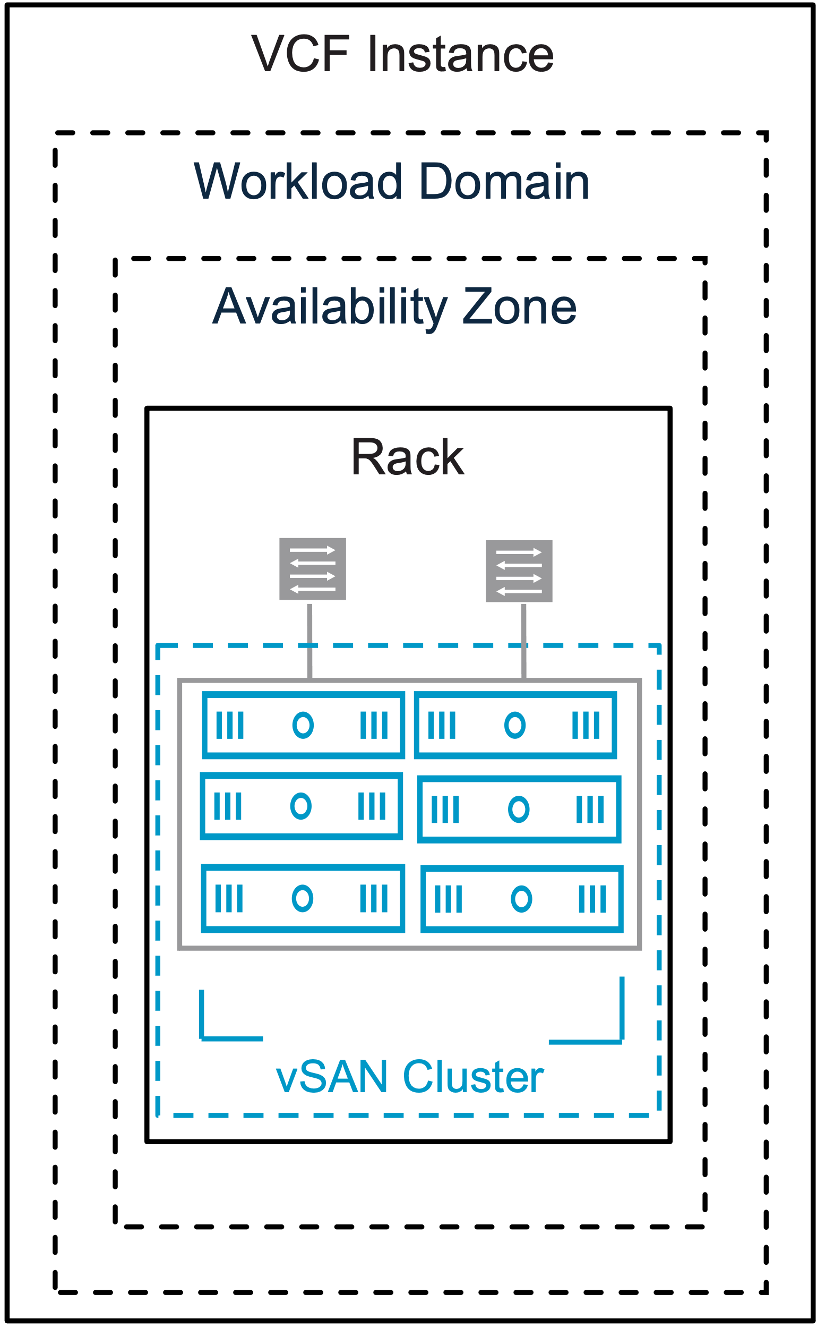
Standard vSAN Cluster – ready for export 24%
Notes:
Version: 1.1
Original Author: Paudie O’Riordan
Change Log:
v1.0 – 19th May 2025 by Paudie O’Riordan
Initial creation
V1.1 – 9th June 2025 by Paudie Oriordan
SVG import readiness

Slide 61

Standard vSAN ESA Cluster
VCF Instance
Workload Domain
Availability Zone
Rack
Storage Pool
Storage Pool
Storage Pool
Storage Pool
vSAN ESA Cluster
Notes:
Version: 1.1
Original Author: Paudie O’Riordan
Change Log:
v1.0 – 19th May 2025 by Paudie O’Riordan
Initial creation
V1.1 – 9th June 2025 by Paudie Oriordan
SVG import readiness

Slide 62
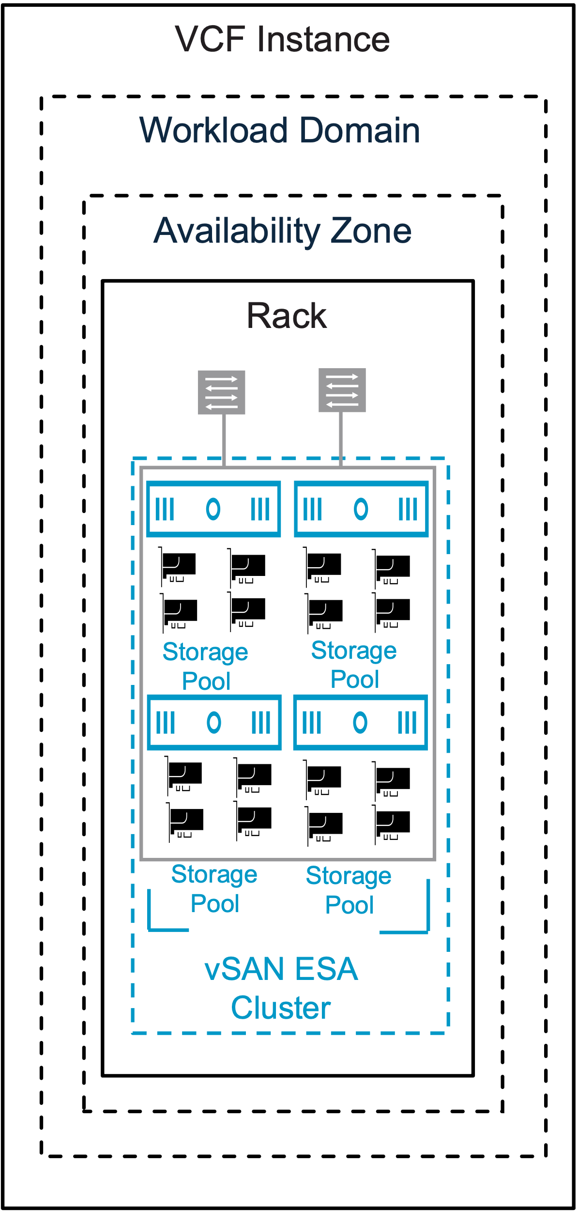
Standard vSAN ESA Cluster – ready for export 24%
Notes:
Version: 1.1
Original Author: Paudie O’Riordan
Change Log:
v1.0 – 19th May 2025 by Paudie O’Riordan
Initial creation
V1.1 – 9th June 2025 by Paudie Oriordan
SVG import readiness

Slide 63
Standard vSAN OSA Cluster
VCF Instance
Workload Domain
Availability Zone
Rack
Disk Groups
Disk Groups
Disk Groups
Disk Groups
vSAN OSA Cluster
Notes:
Version: 1.1
Original Author: Paudie O’Riordan
Change Log:
v1.0 – 19th May 2025 by Paudie O’Riordan
Initial creation
V1.1 – 9th June 2025 by Paudie Oriordan
SVG import readiness

Slide 64
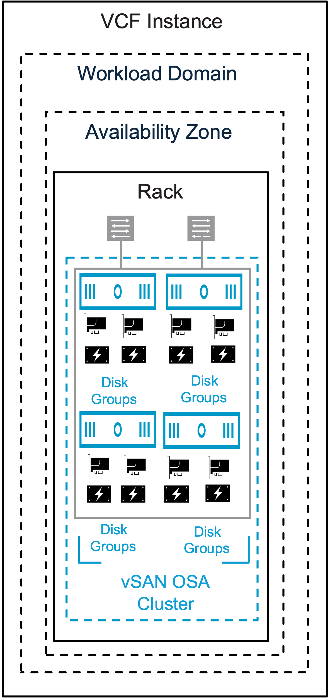
Standard vSAN OSA Cluster – ready for export 24%
Notes:
Version: 1.1
Original Author: Paudie O’Riordan
Change Log:
v1.0 – 19th May 2025 by Paudie O’Riordan
Initial creation
V1.1 – 9th June 2025 by Paudie Oriordan
SVG import readiness

Slide 65

vSAN Compute Cluster original
VCF Instance
Workload Domain
Availability Zone
Rack
vSAN Compute Cluster
Notes:
Version: 1.1
Original Author: Paudie O’Riordan
Change Log:
v1.0 – 19th May 2025 by Paudie O’Riordan
Initial creation
V1.1 – 9th June 2025 by Paudie Oriordan
SVG import readiness

Slide 66
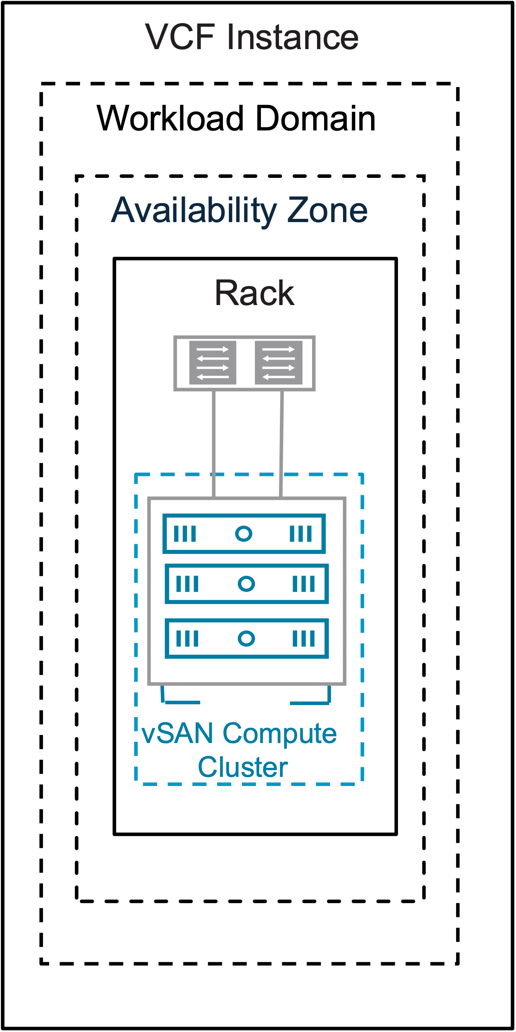
vSAN Compute Cluster – ready for export 24%
Notes:
Version: 1.1
Original Author: Paudie O’Riordan
Change Log:
v1.0 – 19th May 2025 by Paudie O’Riordan
Initial creation
V1.1 – 9th June 2025 by Paudie Oriordan
SVG import readiness

Slide 67
Choices original
Start choosing an architectural model for vSAN
Flash NVMe devices supported with vSAN ESA?
Yes
No
Use vSAN (ESA) Express Storage Architecture.
Use vSAN (OSA) Original Storage Architecture.
Single Tier Storage Architecture.
25Gb Network strongly recommended
Tiered Storage Architecture.
Mix of SAS, SATA or NVMe devices supported
End
Notes:
Version: 1.1
Original Author: Paudie O’Riordan
Change Log:
v1.0 – 19th May 2025 by Paudie O’Riordan
Initial creation
V1.1 – 9th June 2025 by Paudie Oriordan
SVG import readiness

Slide 68
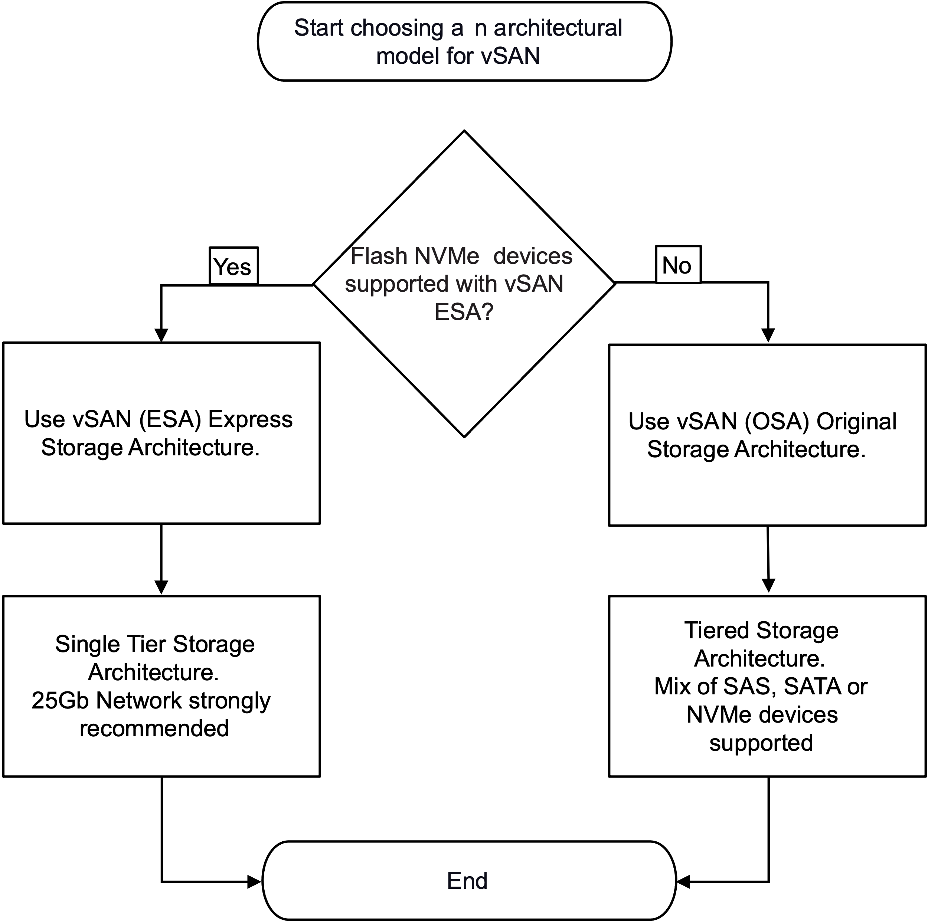
Choices – ready for export 24%
Notes:
Version: 1.1
Original Author: Paudie O’Riordan
Change Log:
v1.0 – 19th May 2025 by Paudie O’Riordan
Initial creation
V1.1 – 9th June 2025 by Paudie Oriordan
SVG import readiness

Slide 69
Single Distributed Switch Model (2-pNiC) v1.1
ESX Host
vDS Uplinks
vDS01
VM Management
ESX Management
vMotion
vSAN
Storage
Virtual Networking
Notes:
Version: 1.1
Original Author: Paudie O’Riordan
Change Log:
v1.1 – 9th June 2025 by Paudie Oriordan
SVG import readiness
Updated the switch objects to reverse the black and white based on standards
v1.0 – 19th May 2025 by Paudie O’Riordan
Initial creation

Slide 70
Storage Separation Distributed Switch Model (4-pNiC) v1.1
ESX Host
vDS Uplinks
vDS Uplinks
vDS01
vDS02
VM Management
ESX Management
vMotion
Virtual Networking
vSAN
Storage
Notes:
Version: 1.1
Original Author: Paudie O’Riordan
Change Log:
v1.1 – 9th June 2025 by Paudie Oriordan
SVG import readiness
Updated the switch objects to reverse the black and white based on standards
v1.0 – 19th May 2025 by Paudie O’Riordan
Initial creation

Slide 71
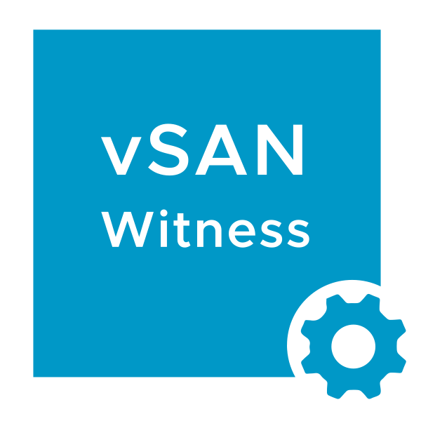
vSAN Stretched Cluster original
VCF Instance
Workload Domain
Availability Zone 3
Availability Zone 1
Availability Zone 2
Rack
Rack
vSAN Stretched Cluster
Notes:
Version: 1.1
Original Author: Paudie O’Riordan
Change Log:
v1.0 – 19th May 2025 by Paudie O’Riordan
Initial creation
V1.1 – 9th June 2025 by Paudie Oriordan
SVG import readiness

Slide 72
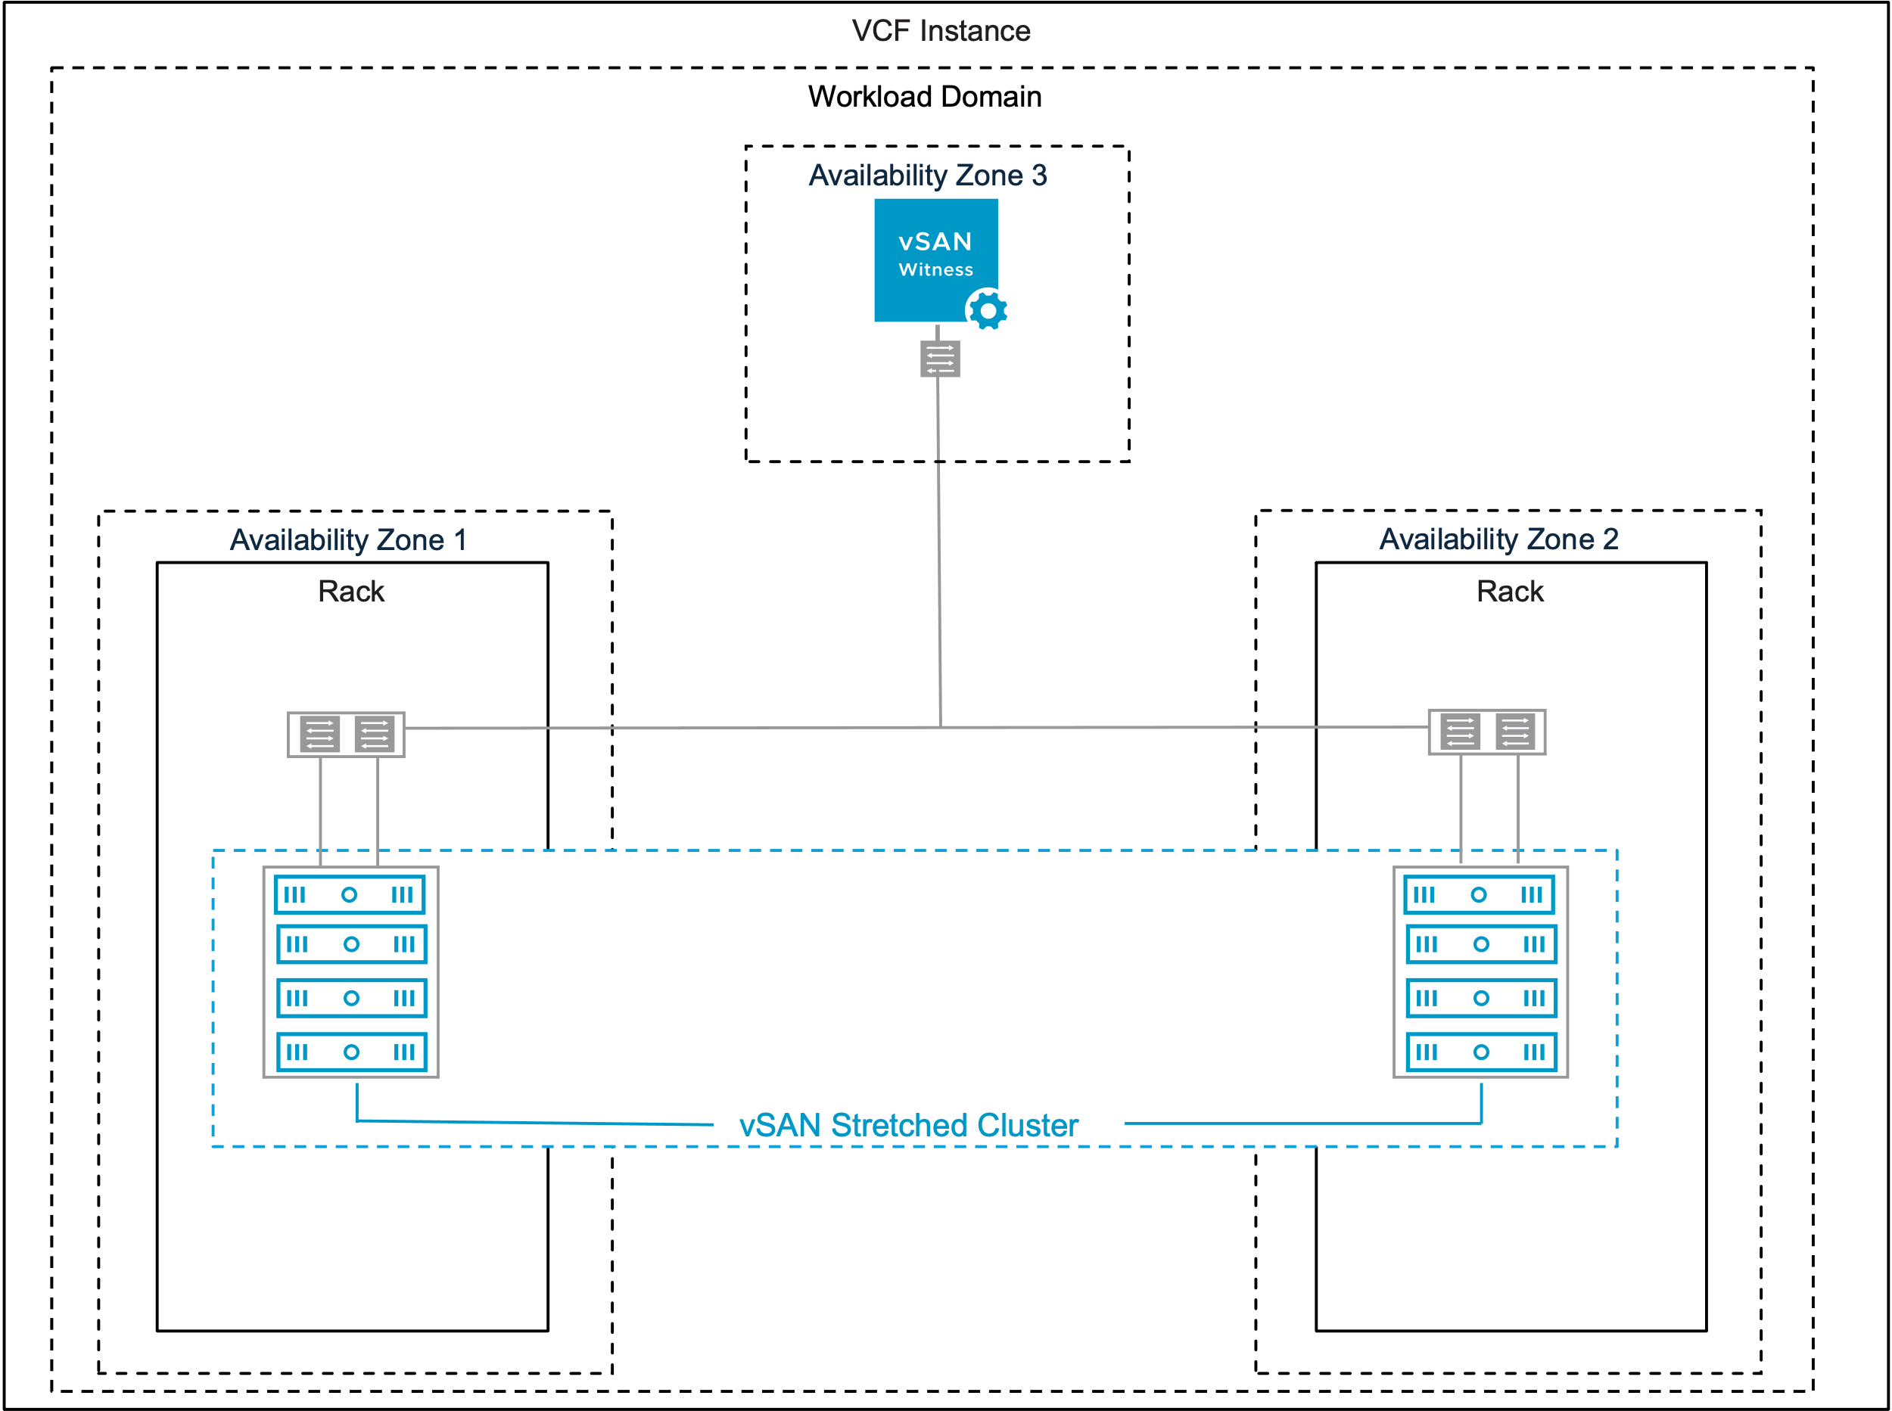
vSAN Stretched Cluster import – ready for export 24%
Notes:
Version: 1.1
Original Author: Paudie O’Riordan
Change Log:
v1.0 – 19th May 2025 by Paudie O’Riordan
Initial creation
V1.1 – 9th June 2025 by Paudie Oriordan
SVG import readiness

Slide 73

vSAN Storage + Compute Clusters original
VCF Instance
Workload Domain
Availability Zone
Rack
Rack
vSAN Compute Cluster
vSAN Storage Cluster
vSAN Compute Cluster
vSAN Compute Cluster
Notes:
Version: 1.1
Original Author: Paudie O’Riordan
Change Log:
v1.0 – 19th May 2025 by Paudie O’Riordan
Initial creation
V1.1 – 9th June 2025 by Paudie Oriordan
SVG import readiness

Slide 74
vSAN Storage + Compute Clusters original
Rack
vSAN Storage Cluster
Notes:
Version: 1.1
Original Author: Paudie O’Riordan
Change Log:
v1.0 – 19th May 2025 by Paudie O’Riordan
Initial creation
V1.1 – 9th June 2025 by Paudie Oriordan
SVG import readiness

Slide 75
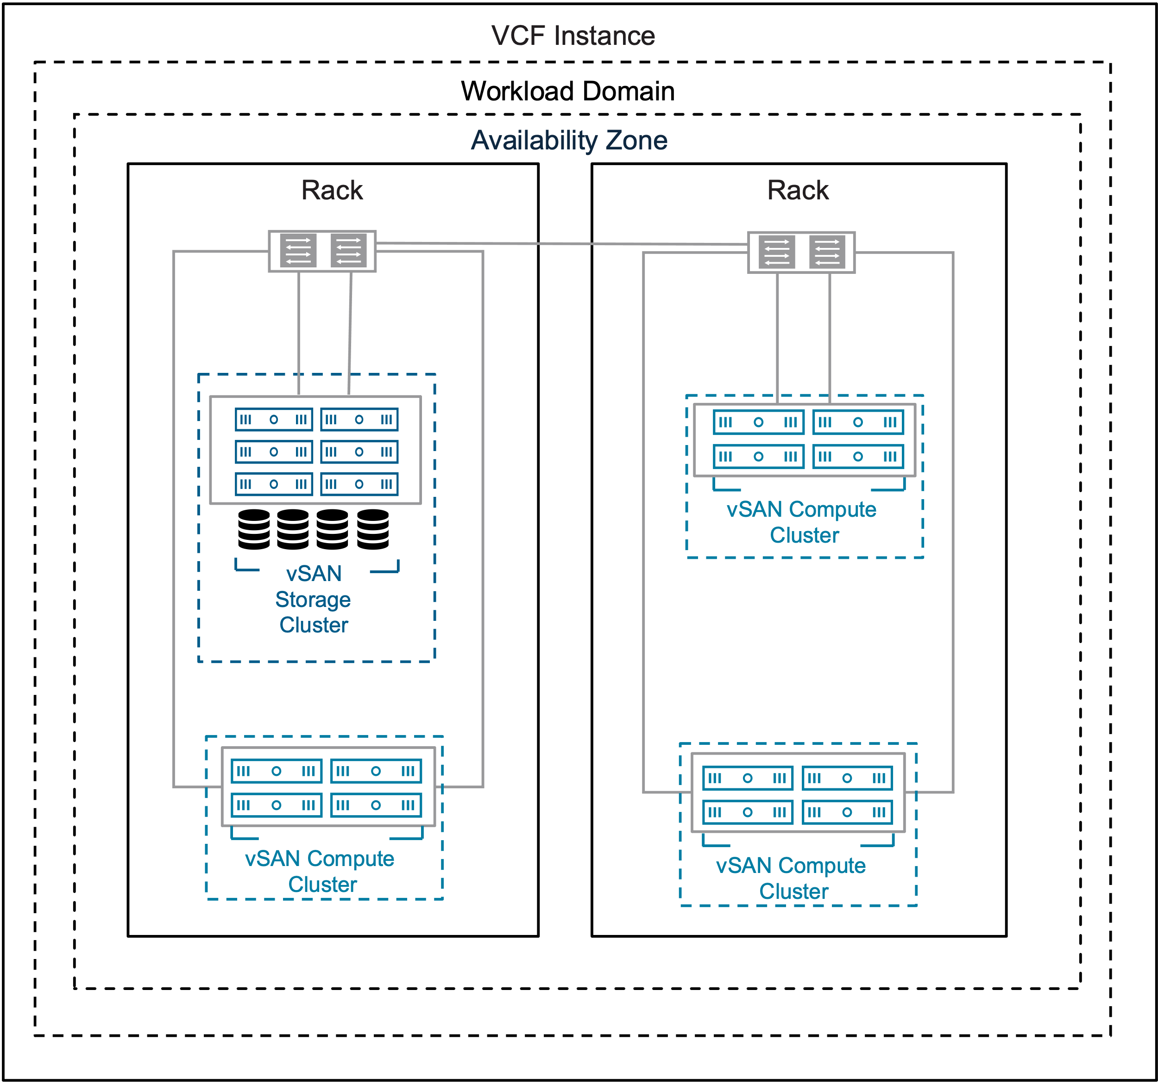
vSAN Storage + Compute Clusters – ready for export 24%
Notes:
Version: 1.1
Original Author: Paudie O’Riordan
Change Log:
v1.0 – 19th May 2025 by Paudie O’Riordan
Initial creation
V1.1 – 9th June 2025 by Paudie Oriordan
SVG import readiness

Slide 76
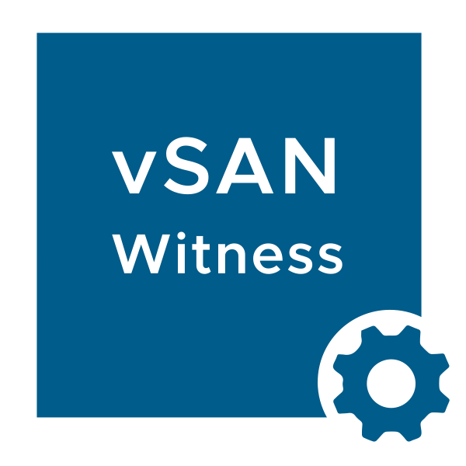
vSAN Stretched-Storage and compute original
VCF Instance
Workload Domain
Availability Zone 3
Availability Zone 1
Availability Zone 2
Rack
Rack
Rack
Rack
vSAN Compute Cluster
vSAN Stretched Storage Cluster
vSAN Compute Cluster
Rack
Rack
vSAN Stretched Compute Cluster
Notes:
Version: 1.1
Original Author: Paudie O’Riordan
Change Log:
v1.0 – 19th May 2025 by Paudie O’Riordan
Initial creation
V1.1 – 9th June 2025 by Paudie Oriordan
SVG import readiness

Slide 77
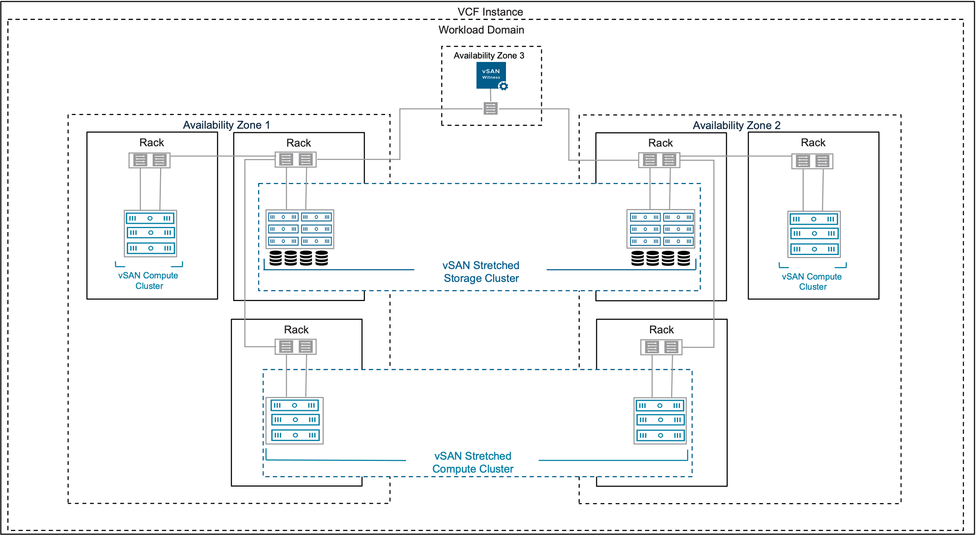
vSAN Stretched-Storage and compute import – ready for export 24%
Notes:
Version: 1.1
Original Author: Paudie O’Riordan
Change Log:
v1.0 – 19th May 2025 by Paudie O’Riordan
Initial creation
V1.1 – 9th June 2025 by Paudie Oriordan
SVG import readiness

Slide 78
vSAN stretched-compute original
VCF Instance
Workload Domain
Availability Zone 1
Availability Zone 2
Rack
Rack
vSAN Stretched Compute Cluster
Notes:
Version: 1.1
Original Author: Paudie O’Riordan
Change Log:
v1.0 – 19th May 2025 by Paudie O’Riordan
Initial creation
V1.1 – 9th June 2025 by Paudie Oriordan
SVG import readiness

Slide 79
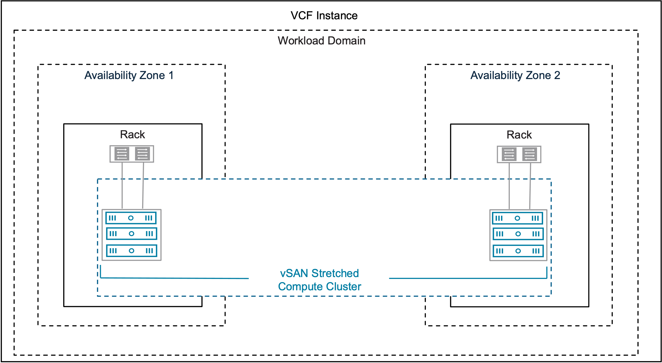
vSAN stretched-compute – ready for export 24%
Notes:
Version: 1.1
Original Author: Paudie O’Riordan
Change Log:
v1.0 – 19th May 2025 by Paudie O’Riordan
Initial creation
V1.1 – 9th June 2025 by Paudie Oriordan
SVG import readiness

Slide 80

Multi-rack / vSAN Fault Domains original
VCF Instance
Workload Domain
Availability Zone
L3
L3
L3
L3
Rack
Rack
Rack
Rack
vSAN Cluster with Fault Domains
Notes:
Version: 1.1
Original Author: Paudie O’Riordan
Change Log:
v1.0 – 19th May 2025 by Paudie O’Riordan
Initial creation
V1.1 – 9th June 2025 by Paudie Oriordan
SVG import readiness

Slide 81
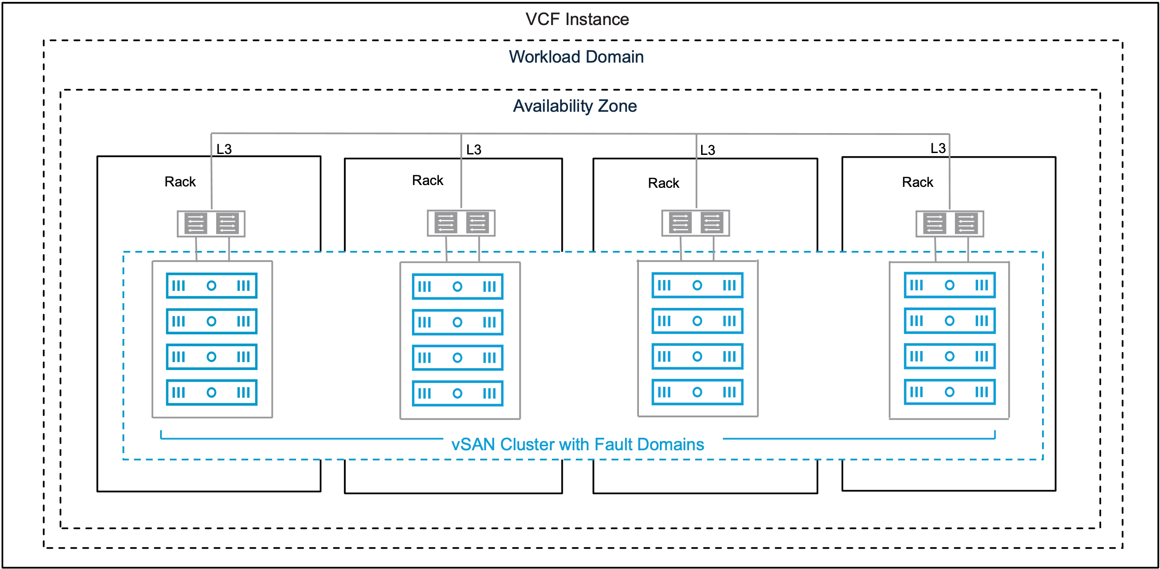
Multi-rack / vSAN Fault Domains – ready for export 24%
Notes:
Version: 1.1
Original Author: Paudie O’Riordan
Change Log:
v1.0 – 19th May 2025 by Paudie O’Riordan
Initial creation
V1.1 – 9th June 2025 by Paudie Oriordan
SVG import readiness

Slide 82
vSAN Datastore Sharing original
VCF Instance
Workload Domain
Availability Zone
Rack
Rack
vSAN Storage Cluster
vSAN Cluster
vSAN Cluster
vSAN Compute Cluster
Notes:
Version: 1.1
Original Author: Paudie O’Riordan
Change Log:
v1.0 – 19th May 2025 by Paudie O’Riordan
Initial creation
V1.1 – 9th June 2025 by Paudie Oriordan
SVG import readiness

Slide 83
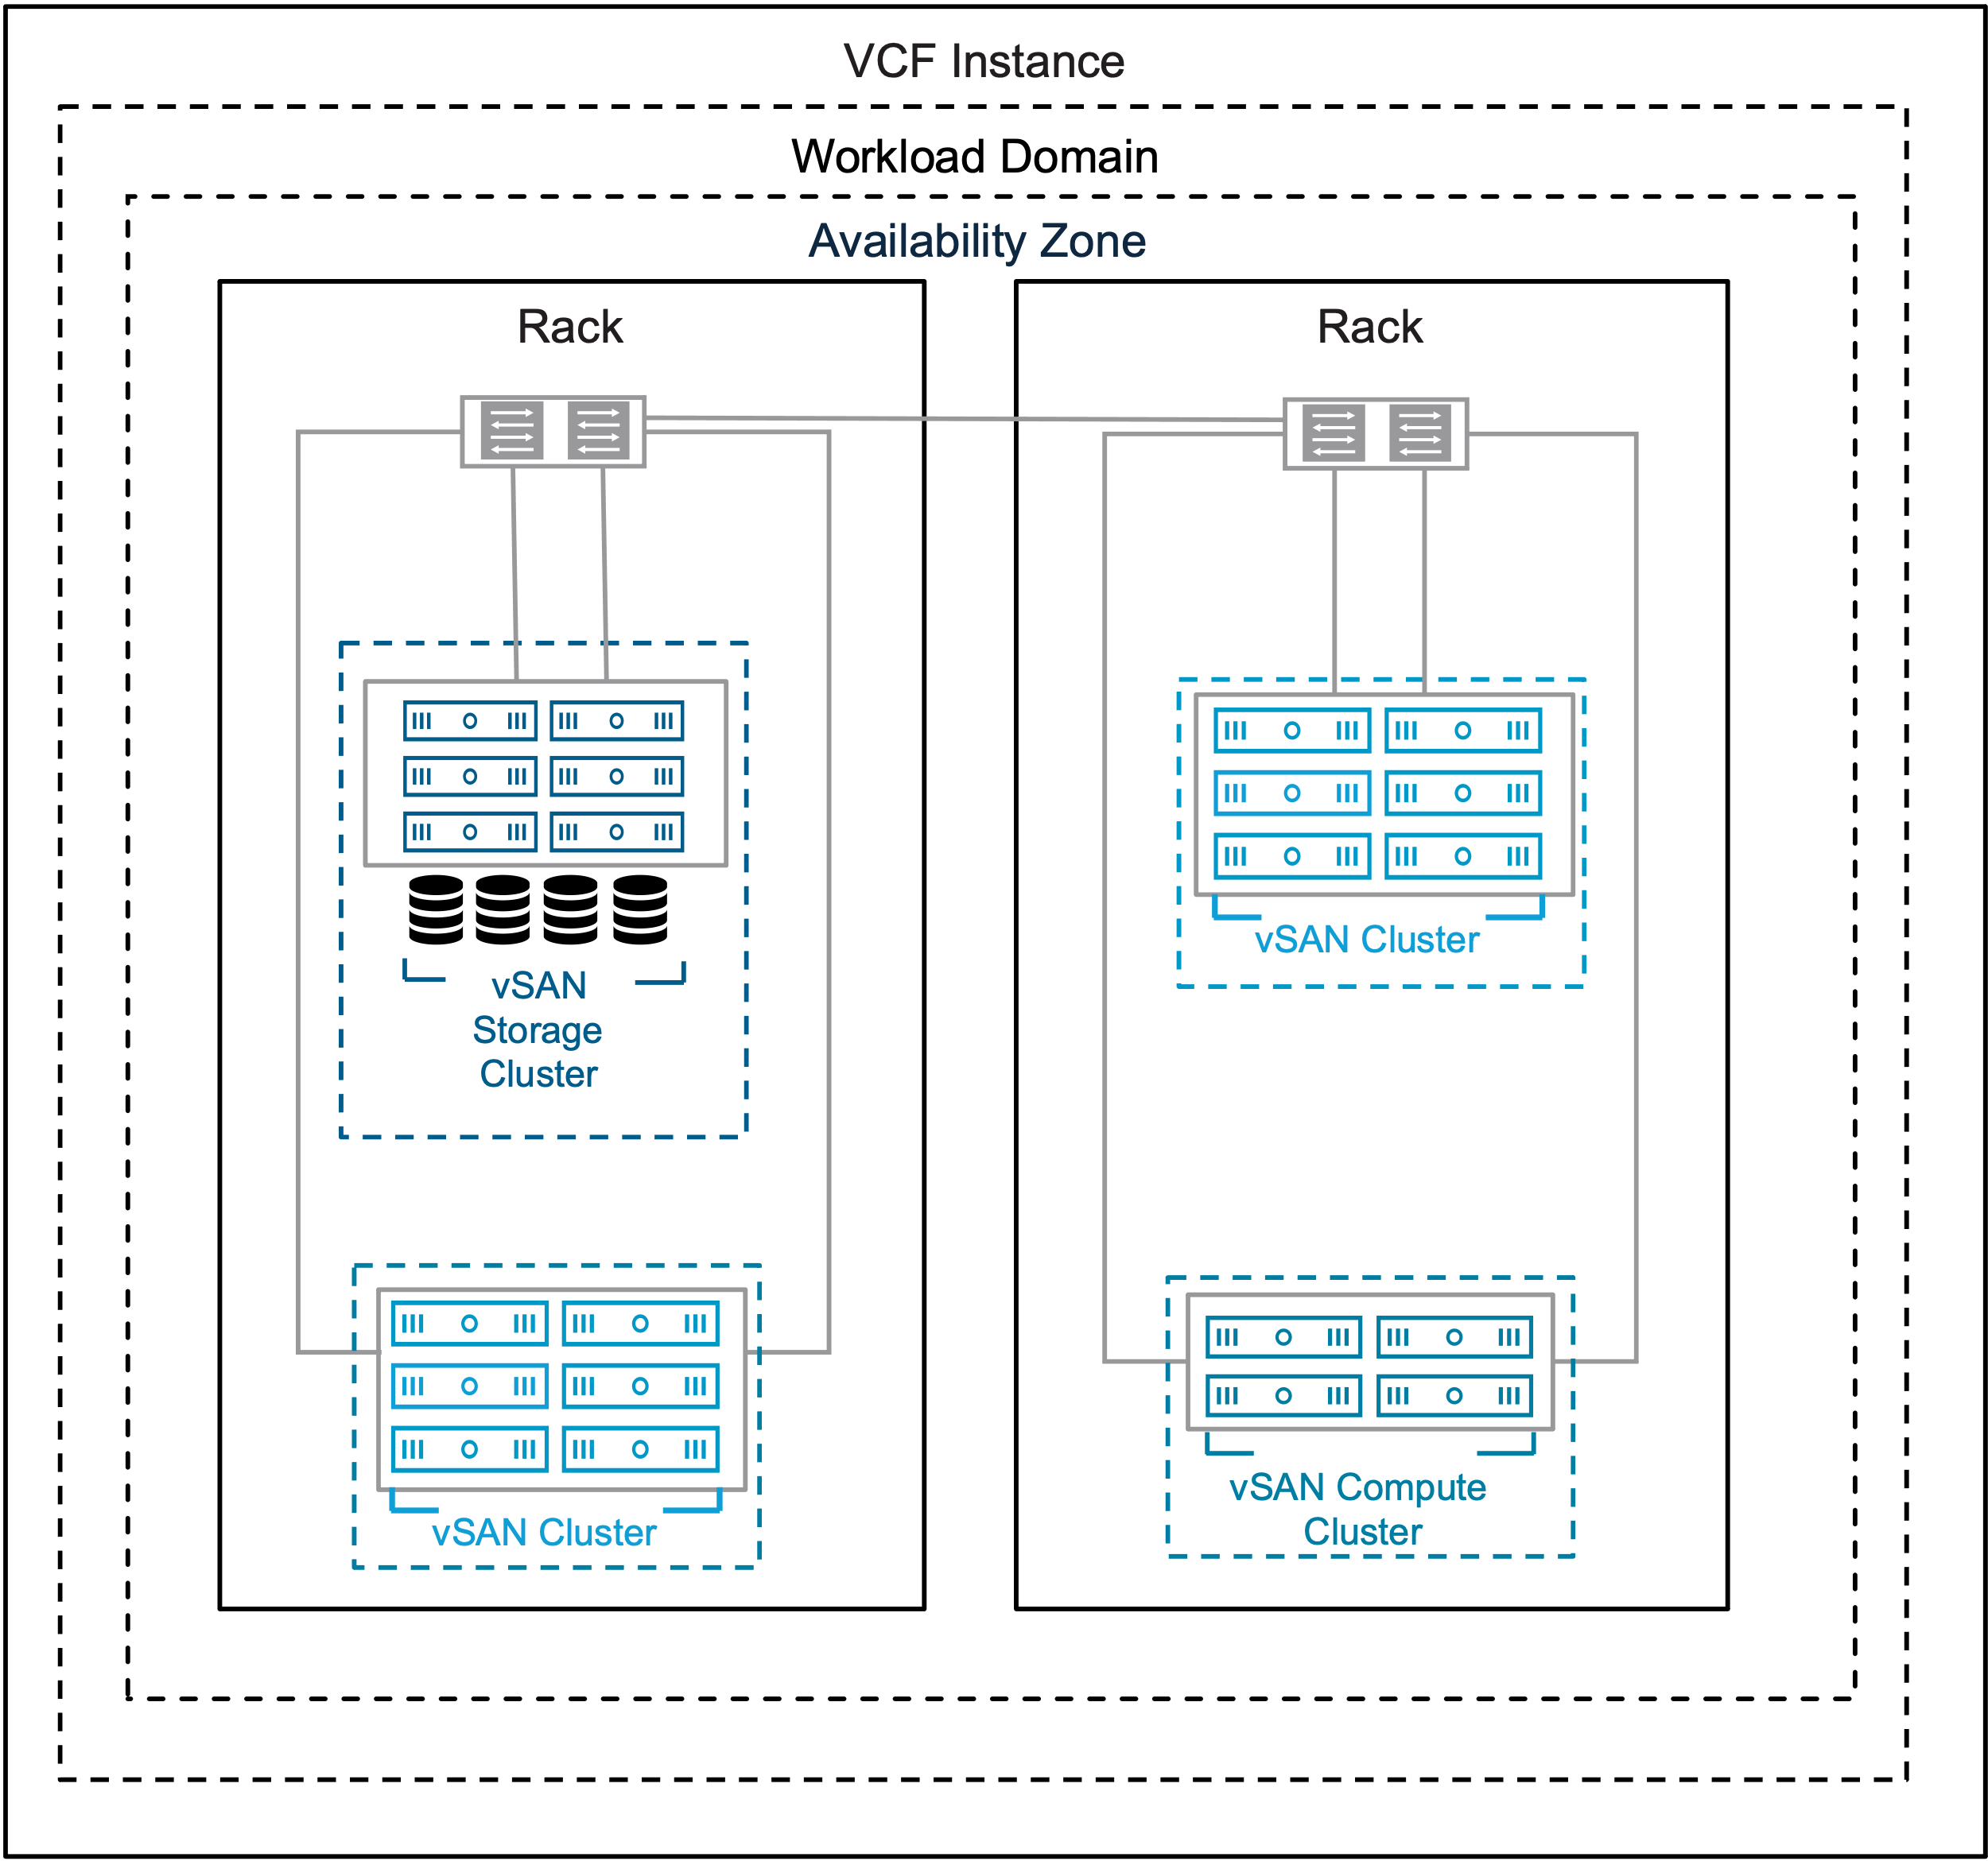
vSAN Datastore Sharing – ready for export 24%
Notes:
Version: 1.1
Original Author: Paudie O’Riordan
Change Log:
v1.0 – 19th May 2025 by Paudie O’Riordan
Initial creation
V1.1 – 9th June 2025 by Paudie Oriordan
SVG import readiness

Slide 84
Multi-rack / L3 vSAN compute cluster original
VCF Instance
Workload Domain
Availability Zone
L3
Rack
vSAN Storage Cluster
L3
L3
L3
Rack
Rack
Rack
vSAN Compute Cluster
Notes:
Version: 1.0
Original Author: Paudie O’Riordan
Change Log:
V1.0 – 10th June 2025 by Paudie Oriordan
original

Slide 85
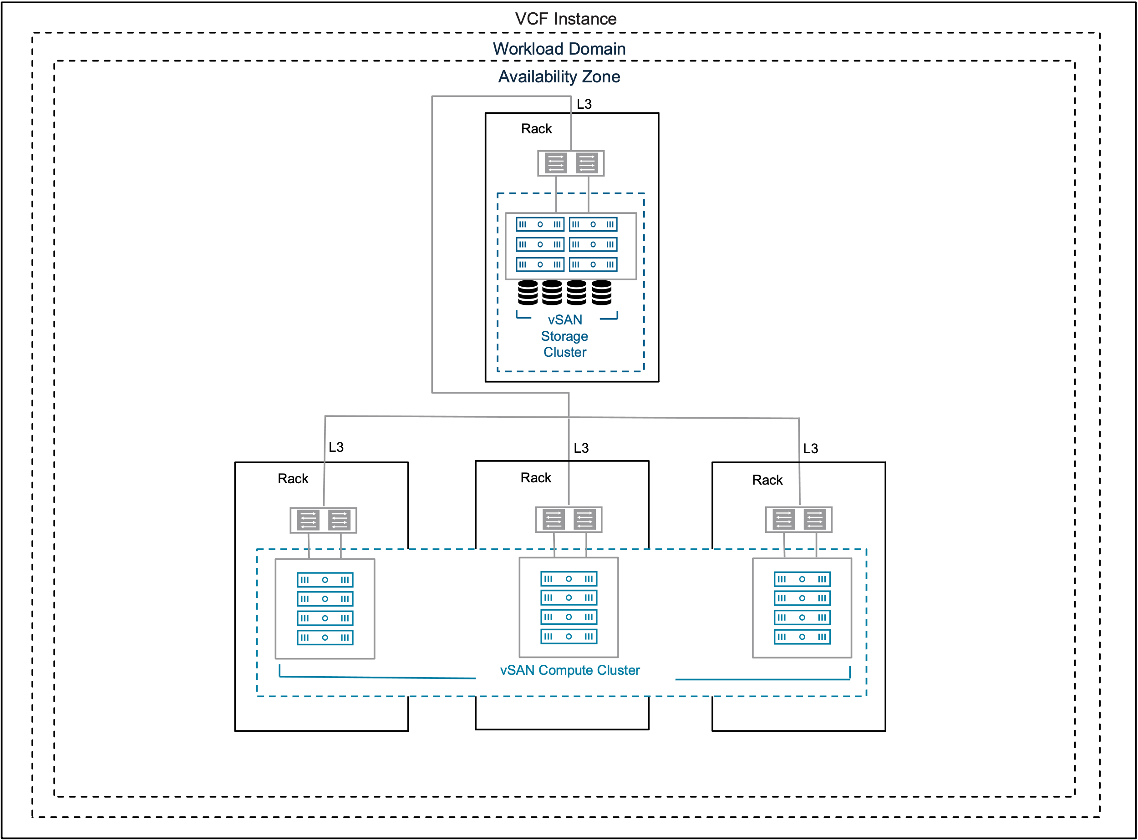
Multi-rack / L3 vSAN compute cluster – ready for export 24%
Notes:
Version: 1.0
Original Author: Paudie O’Riordan
Change Log:
V1.0 – 10th June 2025 by Paudie Oriordan
SVG import readiness

Slide 86

NFS Storage Model v1.0
VCF Instance
Workload Domain
Availability Zone
Rack
IP Storage (NFS)
Notes:
Version: 1.0
Original Author: Gary Blake
Change Log:
v1.0 – 13th June 2025 by Gary Blake
Initial creation based on a version provided by Konstantin Nikolov

Slide 87
Fibre Channel Storage Model v1.0
VCF Instance
Workload Domain
Availability Zone
Rack
Fibre Channel
Notes:
Version: 1.0
Original Author: Gary Blake
Change Log:
v1.0 – 13th June 2025 by Gary Blake
Initial creation based on a version provided by Konstantin Nikolov

Slide 88
NSX Edge Cluster Models
Single Availability Zones

Slide 89

Host Fault Tolerant NSX Edge Cluster v1.0
Layer 2 Adjacencies
Rack 1
BGP
Peers
Layer 2 vSphere Cluster for NSX Edge Nodes
Host Group Affinity
Host Group Affinity
NSX
Edge
Cluster
Host Group
Host Group
Notes:
Version: 1.0
Original Author: Oliver Ziltener
Change Log:
v1.0 – 5ht March 2025 by Oliver Ziltener
Initial creation

Slide 90
Rack Fault Tolerant Design Using Two or More Vertical Layer 2 vSphere Clusters in Separate Racks Model v1.0
Layer 3 Boundaries
Layer 2 Adjacencies
Layer 2 Adjacencies
Rack 1
Rack 2
BGP
Peers
BGP
Peers
Layer 2 vSphere Cluster 01 for NSX Edge Nodes
Layer 2 vSphere Cluster 02 for NSX Edge Nodes
Host Group Affinity
Host Group Affinity
Host Group Affinity
Host Group Affinity
NSX
Edge
Cluster
Host Group
Host Group
Host Group
Host Group
Notes:
Version: 1.0
Original Author: Oliver Ziltener
Change Log:
v1.0 – 5ht March 2025 by Oliver Ziltener
Initial creation

Slide 91
Rack Fault Tolerant Design Using a Single Layer 3 vSphere Cluster Deployed Across Multiple Racks Model v1.0
Layer 3 Boundaries
Layer 2 Adjacencies
Layer 2 Adjacencies
Layer 2 Adjacencies
Layer 2 Adjacencies
Rack 1
Rack 2
Rack 3
Rack 4
BGP
Peers
BGP
Peers
BGP
Peers
BGP
Peers
Layer 3 vSphere Cluster for NSX Edge Nodes
Host Group Affinity
Host Group Affinity
Host Group Affinity
Host Group Affinity
NSX
Edge
Cluster
Notes:
Version: 1.0
Original Author: Oliver Ziltener
Change Log:
v1.0 – 5ht March 2025 by Oliver Ziltener
Initial creation

Slide 92
Rack Fault Tolerant Design Using a Single Layer 2 vSphere Cluster Deployed Across Multiple Racks Model v1.0
Layer 2 Adjacencies
Rack 1
Rack 2
Rack 3
Rack 4
BGP
Peers
BGP
Peers
BGP
Peers
BGP
Peers
Layer 2 vSphere Cluster for NSX Edge Nodes
Host Group Affinity
Host Group Affinity
Host Group Affinity
Host Group Affinity
NSX
Edge
Cluster
Notes:
Version: 1.0
Original Author: Oliver Ziltener
Change Log:
v1.0 – 5ht March 2025 by Oliver Ziltener
Initial creation

Slide 93
NSX Edge Cluster Models
Dual Availability Zones

Slide 94
Dual Availability Zone Design based on NSX Edge Node HA - Dedicated vSphere Cluster v1.0
Availability Zone 1
Availability Zone 2
Rack 1 – AZ1
Rack 1 – AZ2
BGP
Peers
BGP
Peers
Layer 2 vSphere Cluster 01 for NSX Edge Nodes
Layer 2 vSphere Cluster 02 for NSX Edge Nodes
Host Group Affinity
Host Group Affinity
Host Group Affinity
Host Group Affinity
NSX
Edge
Cluster
Host Group
Host Group
Host Group
Host Group
Notes:
Version: 1.0
Original Author: Oliver Ziltener
Change Log:
v1.0 – 5ht March 2025 by Oliver Ziltener
Initial creation

Slide 95
Dual Availability Zone Design based on NSX Edge Node HA - Stretched vSAN Cluster v1.0
Availability Zone 1
Availability Zone 2
Rack 1 – AZ1
Rack 1 – AZ2
BGP
Peers
BGP
Peers
Stretched vSAN Cluster for NSX Edge Nodes
Host Group Affinity
Host Group Affinity
Host Group Affinity
Host Group Affinity
NSX
Edge
Cluster
Host Group
Host Group
Host Group
Host Group
Notes:
Version: 1.0
Original Author: Oliver Ziltener
Change Log:
v1.0 – 5ht March 2025 by Oliver Ziltener
Initial creation

Slide 96
Dual Availability Zone Design based on vSphere HA Recovery v1.0
Availability Zone 1
Availability Zone 2
Rack 1 – AZ1
Rack 1 – AZ2
BGP
Peers
BGP
Peers
Stretched vSAN Cluster for NSX Edge Nodes
NSX
Edge
Cluster
Notes:
Version: 1.0
Original Author: Oliver Ziltener
Change Log:
v1.0 – 5ht March 2025 by Oliver Ziltener
Initial creation

Slide 97
NSX Management and Control Plane

Slide 98
Networking

Slide 99
VCF Single Sign-On

Slide 100
VCF Identity Broker Models v1.0
Embedded VCF Identity Broker
Appliance VCF Identity Broker
VCF Fleet
VCF Fleet
VCF Instance
VCF Instance
vCenter
vCenter
VCF Identity Broker
NSX Manager
VCF Identity Broker
NSX Manager
VCF Operations
VCF Operations
VCF Automation
Tenant Identity Provider
VCF Automation
Tenant Identity Provider
HCX
HCX
Customer Identity Provider
Customer Identity Provider
Notes:
Version: 1.0
Original Author: Ian Allie and David Zhang
Change Log:
v1.0 - 06 June 2025 by Gary Blake
Created single slide showing VCF Identity Broker models side by side for use within the Architectural Options section
Added white solid fill to objects to handle dark mode being enabled on the technical docs site
v0.9 – 30 May 2025 by David Zhang
Apply format requirements.
v0.8 – 15 May 2025 by David Zhang
Add NSX Manager and HCX to the model.
V0.7 – 15 Aprl 2025 by David Zhang
Add Appliance VCF Identity Broker Diagram
v0.1 – 07 January 2025 by Ian Allie
Initial creation of embedded VCF Identity Broker Diagram

Slide 101

VCF Identity Broker Models v1.0
VCF Instance
VCF Instance
VCF Operations
NSX
Manager
HCX
VCF Automation
VCF Operations
NSX
Manager
vCenter
HCX
VCF Automation
vCenter
VCF Identity Broker Cluster
VCF Identity Broker
VCF Identity Broker
VCF Identity Broker
VCF Identity Broker
Customer Identity Provider
Customer Identity Provider
Notes:
Version: 1.0
Original Author: Ian Allie
Change Log:
v1.0 - 06 June 2025 by Gary Blake
Added white solid fill to objects to handle dark mode being enabled on the technical docs site
Updated all text to us Metropolis, possible Google Slides issue where opening in that tool resets everything to Arial
Updated the VCF Identity Broker lines to align with color standard for Security and Governance
v0.9 – 30 May 2025 by David Zhang
Apply format requirements
v0.8 – 15 May 2025 by David Zhang
Add NSX Manager and HCX to the model.
v0.1 – 07 January 2025 by Ian Allie
Initial creation of embedded and appliance images

Slide 102
VCF Single Sign-on Design v1.0
VCF Fleet-Wide SSO Model
Single VCF Instance SSO Model
VCF Fleet West
VCF Fleet East
VCF Fleet West
VCF Fleet East
VCF Management
VCF Management
VCF Management
VCF Management
VCF Operations
VCF Automation
VCF Operations
VCF Automation
VCF Operations
VCF Automation
VCF Operations
VCF Automation
VCF Instance
us-west-2
VCF Identity Broker 2
VCF Instance
us-east-2
VCF Identity Broker 4
VCF Instance
us-west-2
VCF Instance
us-east-2
VCF Identity Broker 1
VCF Identity Broker 2
VCF Instance
us-west-1
VCF Identity Broker 1
VCF Instance
us-east-1
VCF Identity Broker 3
VCF Instance
us-west-1
VCF Instance
us-east-1
Customer Identity Provider
Customer Identity Provider
Notes:
Version: 1.0
Original Author: David Zhang
Change Log:
v1.0 – 5th Jun 2025 by David Zhang
Add VCF Management
v0.9 – 25 May 2025 by David Zhang
Redefine and redraw all models.
v0.1 – 9th January 2025 by Ian Allie
Initial creation

Slide 103
VCF Single Sign-on Design v1.0
Cross VCF Instance SSO Model
VCF Fleet
VCF Management
VCF Operations
VCF Automation
VCF Instance
us-east-3
VCF Instance
us-west-2
VCF Instance
us-east-2
VCF Instance
us-west-1
VCF Identity Broker 1
VCF Instance
us-east-1
VCF Identity Broker 2
Customer Identity Provider
Notes:
Version: 1.0
Original Author: David Zhang
Change Log:
Initial creation on 5th Jun 2025

Slide 104
VCF Automation Enterprise Authentication Model v1.0
VCF Automation
VCF Identity Broker Service
VCF Identity Broker
VCF Identity Broker
VCF Identity Broker
Provider
Tenant A
IdP
Tenant B
Notes:
Version: 1.0
Original Author: Ian Allie
Change Log:
v1.0 – 2 Jun 2025 updated by David Zhang
Apply format requirements
v0.8 – Apr 2025 updated by Collin Smith
Change to use VCF Identity Broker Service
v0.1 – 9th January 2025 by Ian Allie
Initial creation

Slide 105
VCF Automation Service Provider Authentication Model v1.0
VCF Automation
Tenant A’s IdP
VCF Identity Broker Service
VCF Identity Broker
VCF Identity Broker
VCF Identity Broker
Provider
Tenant A
Tenant B
Tenant B’s IdP
Provider’s IdP
Notes:
Version: 1.0
Original Author: Ian Allie
Change Log:
v1.0 – 2 Jun 2025 updated by David Zhang
Apply format requirements
v0.8 – Apr 2025 updated by Collin Smith
Change to use VCF Identity Broker Service
v0.1 – 9th January 2025 by Ian Allie
Initial creation

Slide 106
Supervisor Models

Slide 107
Simplified Supervisor Model v1.0
Workload Domain
vCenter
NSX
vSphere Cluster
vSphere Zone (Management and Workload)
vSphere Supervisor
Control Plane VM
VM Service
Namespace
Virtual Machines
Datastore
Notes:
Version: 1.0
Original Author: Jeff Wong
Change Log:
v1.0 – 3rd March 2025 by Jeff Wong
Initial creation

Slide 108
Single Management Zone with Combined Workload Zones Model v1.0
Workload Domain
vCenter
NSX
vSphere Cluster 1
vSphere Zone 1 (Management and Workload)
vSphere Supervisor
Control Plane VMs
vSphere Namespace A
VKS Cluster
vSphere Namespace B
Virtual Machines
Datastore 1
Notes:
Version: 1.0
Original Author: Jeff Wong
Change Log:
v1.0 – 3rd March 2025 by Jeff Wong
Initial creation

Slide 109
Single Management Zone with Isolated Workload Zones Model v1.0
Workload Domain
vCenter
NSX
vSphere Cluster 1
vSphere Cluster 2
vSphere Cluster 3
vSphere Cluster 4
vSphere Zone 1 (Management)
vSphere Zone 2 (Workload)
vSphere Zone 3 (Workload)
vSphere Zone 4 (Workload)
Supervisor
vSphere Supervisor
vSphere Namespace A
Control Plane VMs
VKS Clusters
vSphere Namespace B
vSphere Namespace C
VKS Clusters
Virtual Machines
Datastore 1
Datastore 2
Datastore 3
Datastore 4
Notes:
Version: 1.0
Original Author: Jeff Wong
Change Log:
v1.0 – 3rd March 2025 by Jeff Wong
Initial creation

Slide 110
Three Management Zones with Combined Workload Zones Model v1.0
Workload Domain
vCenter
NSX
vSphere Cluster 1
vSphere Cluster 2
vSphere Cluster 3
vSphere Zone 1 (Management and Workload)
vSphere Zone 2 (Management and Workload)
vSphere Zone 3 (Management and Workload)
vSphere Supervisor
Control Plane VM 1
Control Plane VM 2
Control Plane VM 3
vSphere Namespace A
VKS Clusters
vSphere Namespace B
vSphere Namespace C
vSphere Pods
Virtual Machines
Datastore 1
Datastore 2
Datastore 3
Notes:
Version: 1.0
Original Author: Jeff Wong
Change Log:
v1.0 – 3rd March 2025 by Jeff Wong
Initial creation

Slide 111
Three Management Zones with Isolated Workload Zones Model v1.0
Workload Domain
vCenter
NSX
vSphere Cluster 1
vSphere Cluster 2
vSphere Cluster 3
vSphere Cluster 4
vSphere Cluster 5
vSphere Cluster 6
vSphere Zone 1 (Management)
vSphere Zone 2 (Management)
vSphere Zone 3 (Management)
vSphere Zone 4 (Workload)
vSphere Zone 5 (Workload)
vSphere Zone 6 (Workload)
vSphere Supervisor
vSphere Namespace A
VKS Cluster
Control Plane VM1
Control Plane VM2
Control Plane VM3
vSphere Namespace B
vSphere Namespace C
vSphere
Pods
Virtual Machines
Datastore 1
Datastore 2
Datastore 3
Datastore 4
Datastore 5
Datastore 6
Notes:
Version: 1.0
Original Author: Jeff Wong
Change Log:
v1.0 – 3rd March 2025 by Jeff Wong
Initial creation

Slide 112
Simple Control Plane Model v1.0
Workload Domain
vCenter
NSX
vSphere Cluster
vSphere Zone
vSphere Supervisor
Control Plane VM
Notes:
Version: 1.0
Original Author: Jeff Wong
Change Log:
v1.0 – 3rd March 2025 by Jeff Wong
Initial creation

Slide 113
High Availability Control Plane Model v1.0
Single Management Zone
Three Management Zones
Workload Domain
Workload Domain
vCenter
NSX
vCenter
NSX
vSphere Cluster
vSphere Cluster 1
vSphere Cluster 2
vSphere Cluster 3
vSphere Zone
vSphere Zone 1
vSphere Zone 2
vSphere Zone 3
vSphere Supervisor
vSphere Supervisor
Control Plane VMs
Control Plane VM 1
Control Plane VM 2
Control Plane VM 3
Notes:
Version: 1.0
Original Author: Jeff Wong
Change Log:
v1.0 – 3rd March 2025 by Jeff Wong
Initial creation

